Slide 1


Slide 2

CONTRIBUTION TO Solving GRAND CHALLENGES
We have natural greenhouse effect
  Without it the mean surface T ca - 18 ºC
  Now ca 14 ºC
  Climate is changing but how?
Climate
change
DISCIPLINES
Natural Sciences
Social Sciences
Medicine
Technology etc
PEEX / IEAS Science Diplomacy/TWAS
WMO/GAW Global SMEAR ICOS, ACTRIS, eLTER
From ideas to implementation
Earthquakes
Volcanoes
Air quality
Energy
Fresh water
Biodiversity
loss
Ocean
acidification
Epidemic
diseases
Deforestation
Food supplies
Chemicalisation
Demography / Population /Urbanization

Slide 3
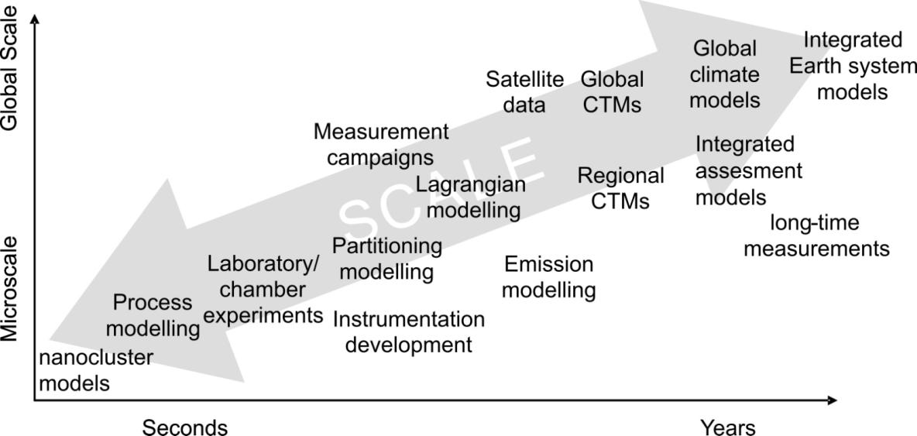
Grand Challenges:
How to answer
clear and ambitious vision / from deep understanding to practical solutions
empirical and experimental / modelling and new theories
multidisciplinary (physics, chemistry, biology, meteorology, economy, social sciences etc)
from research to innovations; new SMEs
Applied Research
Innovations
Society
Policy
Basic Research
New knowledge
From new money
New money from new knowledge

Slide 4
The Global Energy Challenge
United Nations, World Population Prospects 2019, Medium variant
OECD (2022) Real GDP long-term forecast
IEA (2021), World Energy Outlook 2021, IEA, Paris, Stated policies scenario (STEPS)
Notes:
The world population will continue to grow. The GDP growth will be largest in the developing countries. The GDP growth will continue to be depended on energy consumption.

Slide 5
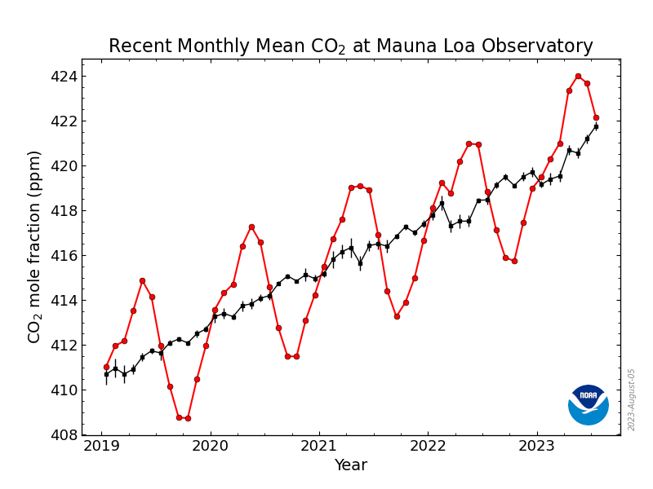
409.65
May 2018:
411.44 ppm
May 2019:
414.86 ppm
May 2020: 417.31 ppm
May 2021:
419.31 ppm
May 2022:
420.99 ppm
May 2023:
424.00 ppm
407.70
403.94
401.78

Slide 6
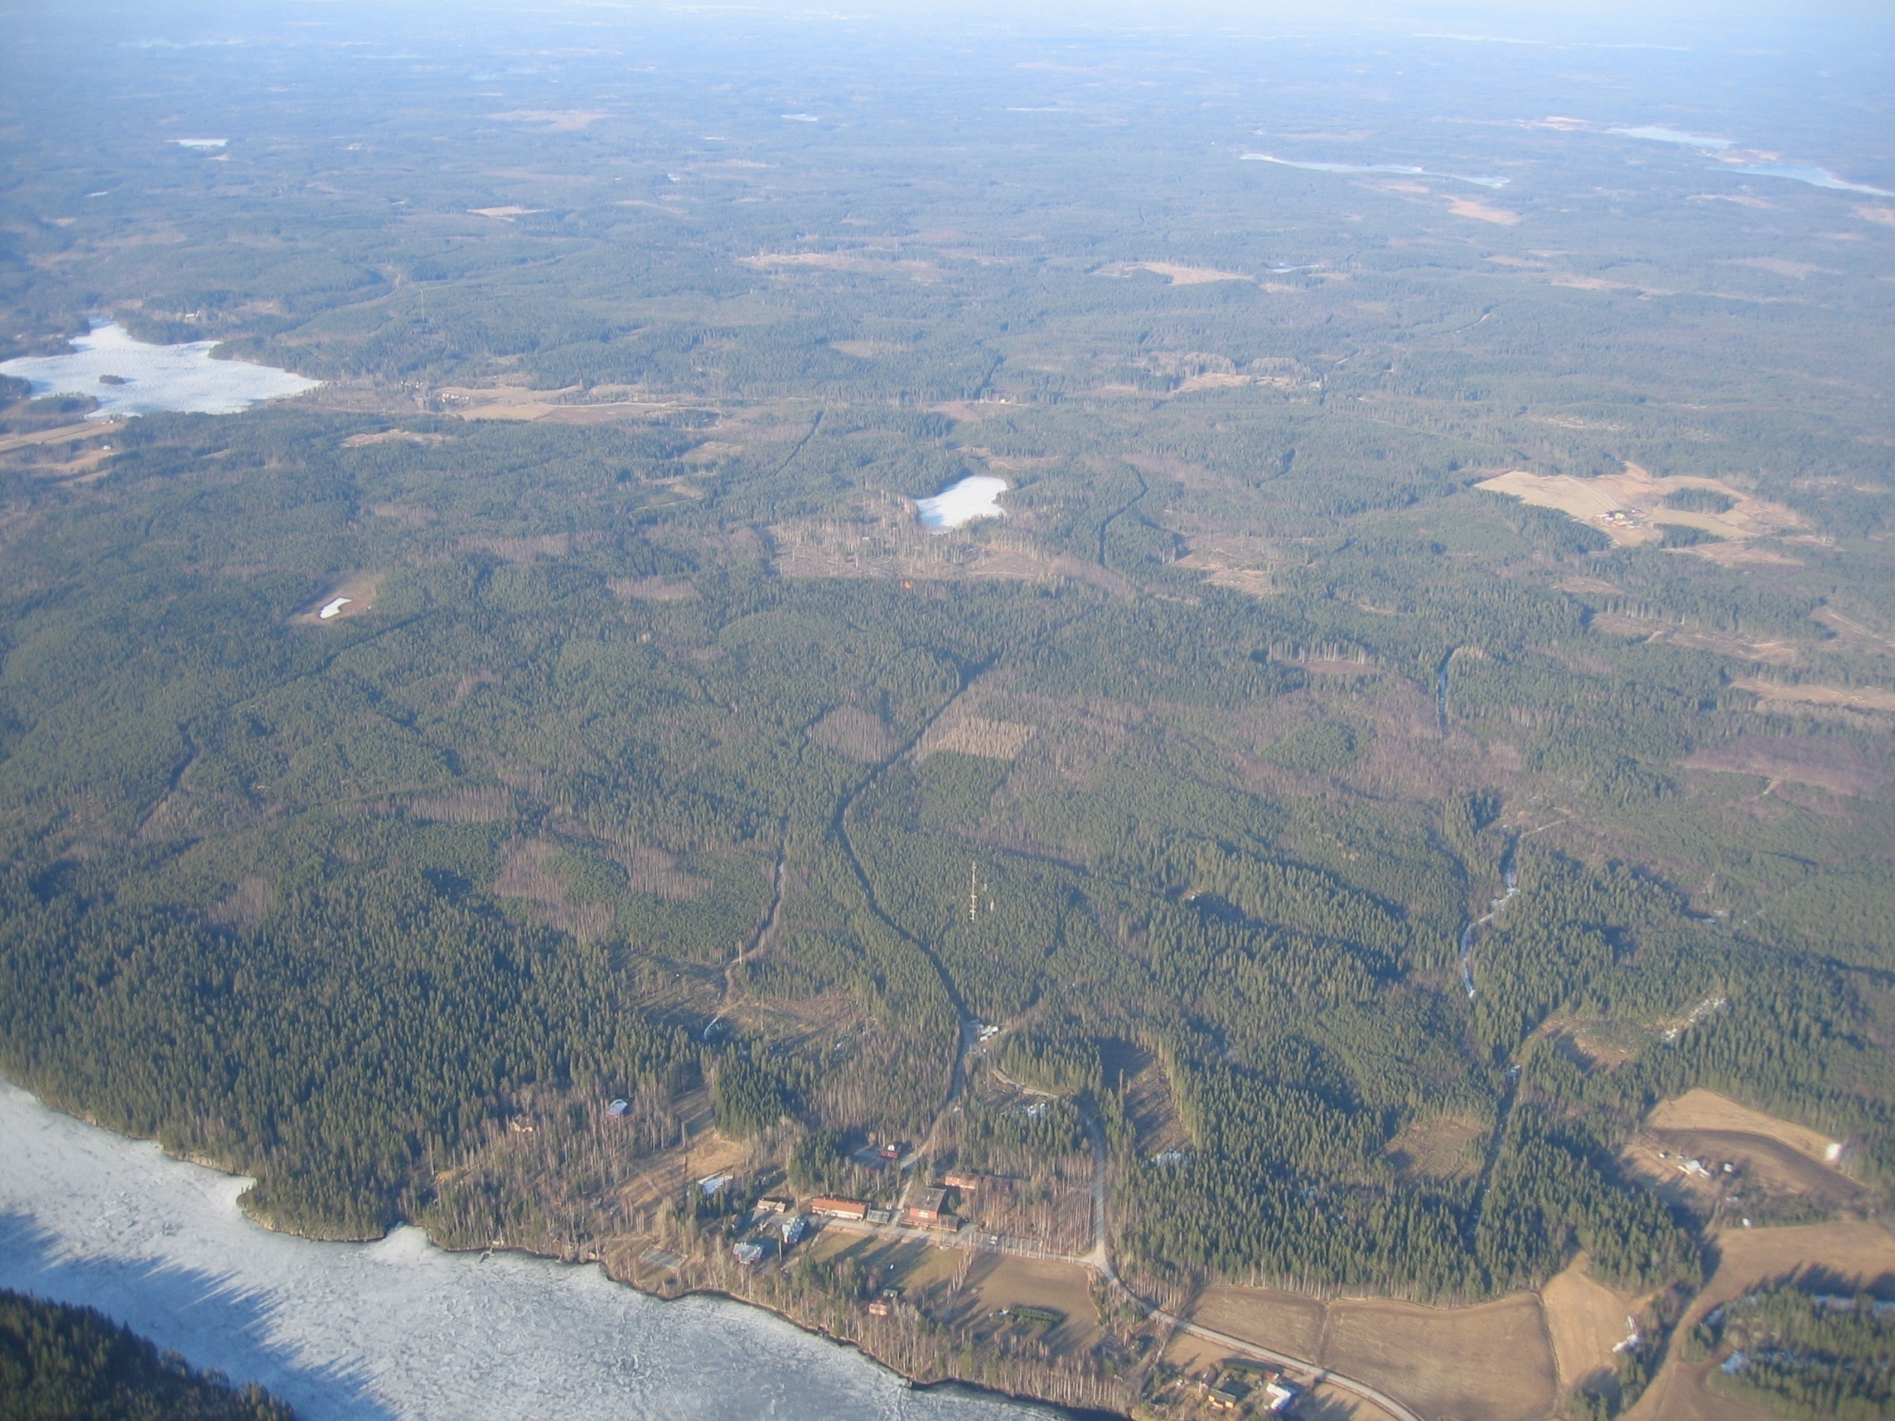
SMEAR II-station (boreal forest, country side)

Slide 7
YES: we can measure the sink / CARBON partitioning
Needle respiration
300 g C m⁻²
The net carbon sequestration 200-250 g C m⁻² a⁻¹
CO₂
Needle photosynthesis
1100 g C m⁻²
Soil carbon efflux 600 g C m⁻²
Wood respiration
100 g C m⁻²
Root respiration
Decomposition of soil organic matter
Photosynthesis
100 g C m⁻²
Litter production 100 g C m⁻²
Respiration
~75 g C m⁻²
Root exudates 100-200 g C m⁻²
Courtesy: Pasi Kolari
Notes:
SMEAR II metsikön hiilivuot

Slide 8
THE POTENTIAL OF SMEAR CONCEPT:
GLOBAL COMPREHENSIVE FEEDBACK ANALYSIS
Clouds
aerosol effects
+ 6 %
Diffuse radiation
Global Radiation
+ 1.5 %
Photosynthesis
Carbon sink
Volatile organic compounds
+ 6 %
CARBON SINK PLUS
VOCs, Aerosols, clouds, precipitation
Max 1.8 x carbon sink (Hyytiälä / SMEAR II results)
Uncertainties
=> observations / models
Arctic-Boreal PEEX area
Eastern Asian PEEX area
Amazonas
Sahara + EMME region
Africa
20 largest metropolitan areas
+ 0.7 %
CO₂
+ 10 ppm
+ 8 %
Kulmala et al., 2014, BER

Slide 9
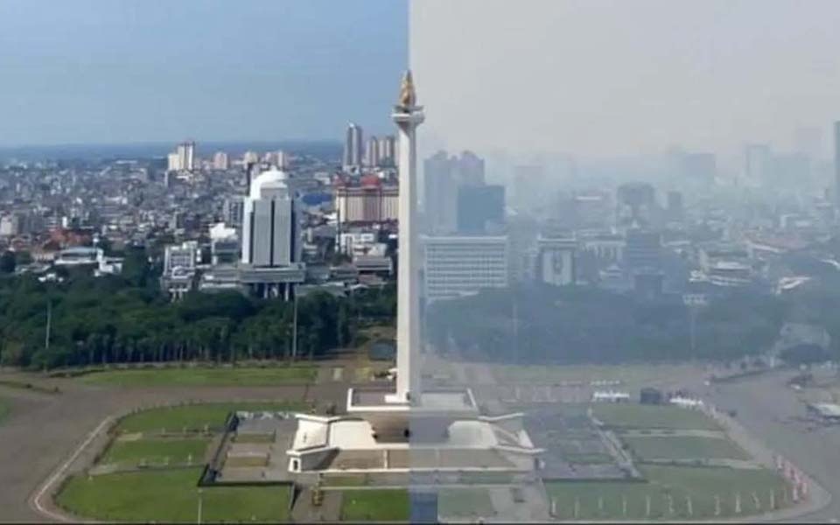
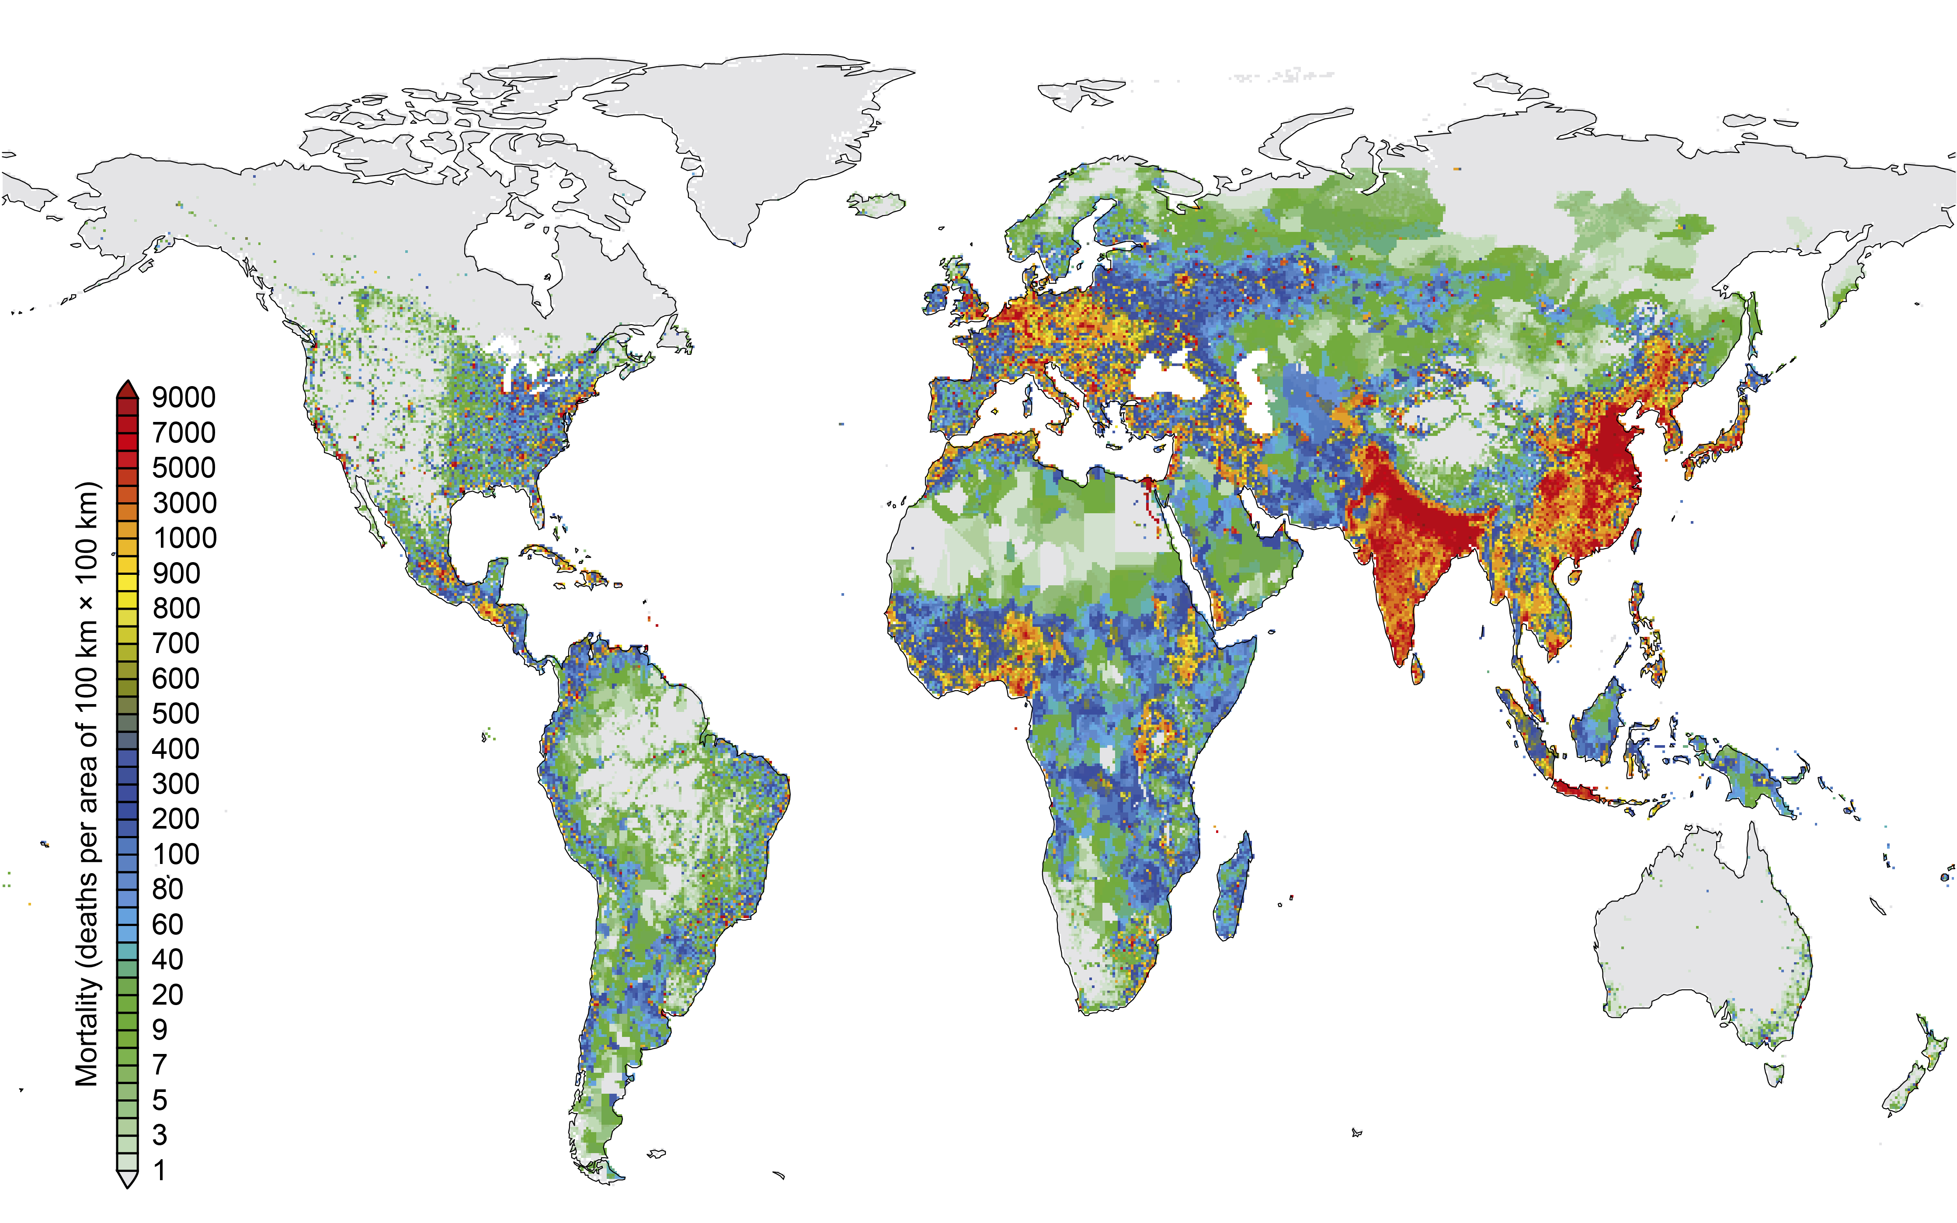
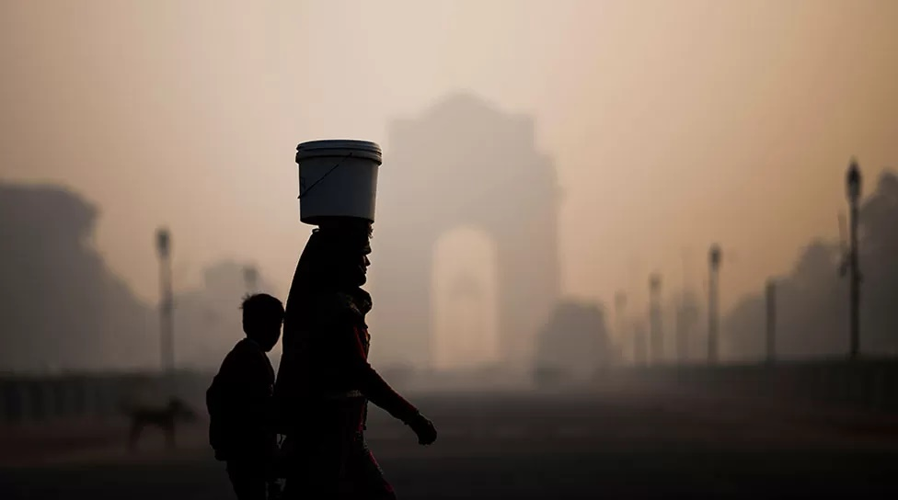
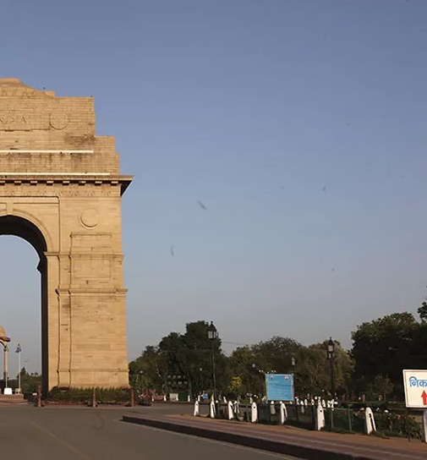
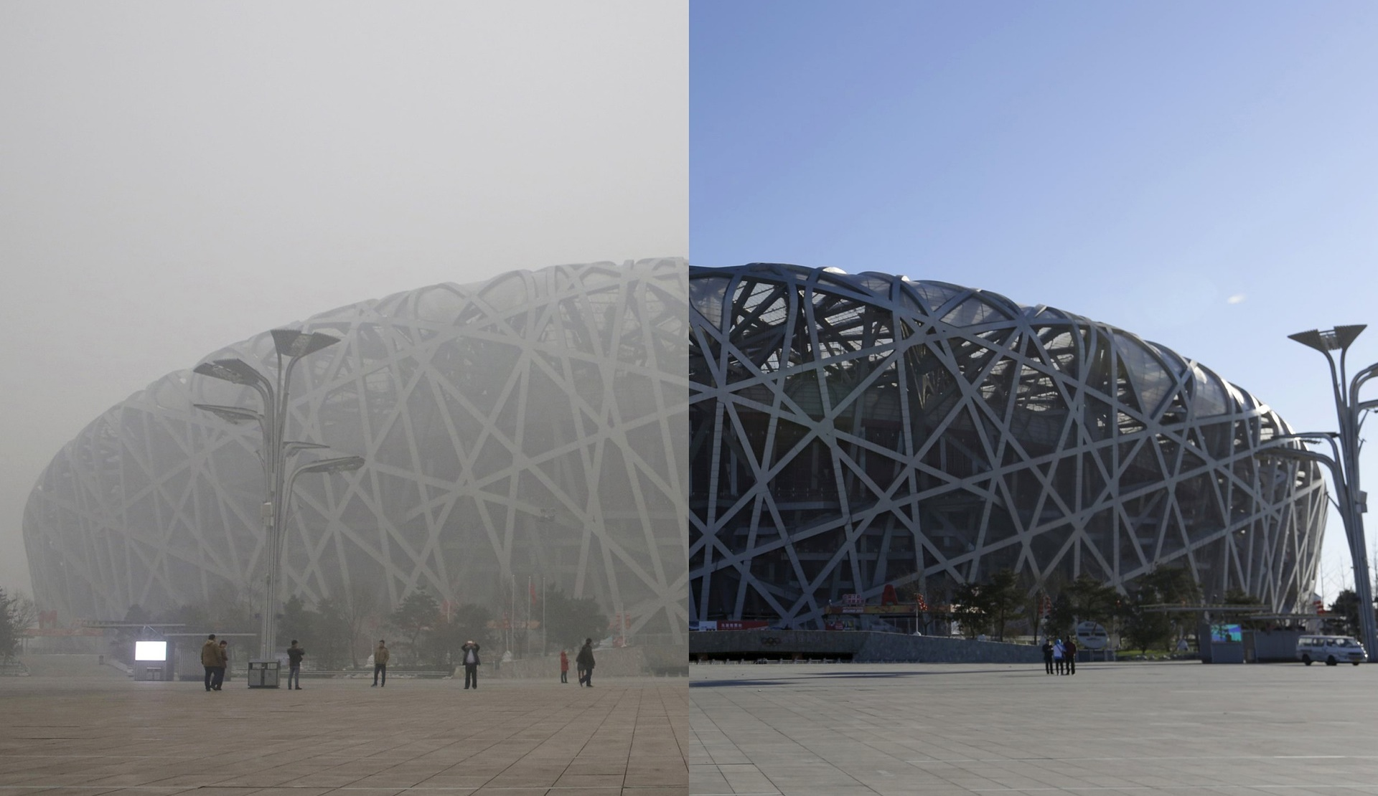
Haze - Air Pollution “Cocktails”
Atmospheric aerosol particles with strong health and climate impact
Up to 9 million pre-mature deaths caused by aerosol pollution in 2019
Haze vs. clear blue sky
Jakarta
Delhi
Beijing
Aerosols remain the largest uncertainty in climate assessment (IPCC, 2021)
Ni & Cheng 2023; Burnett PNAS 2018; GBD Lancet 2020
9/10

Slide 10
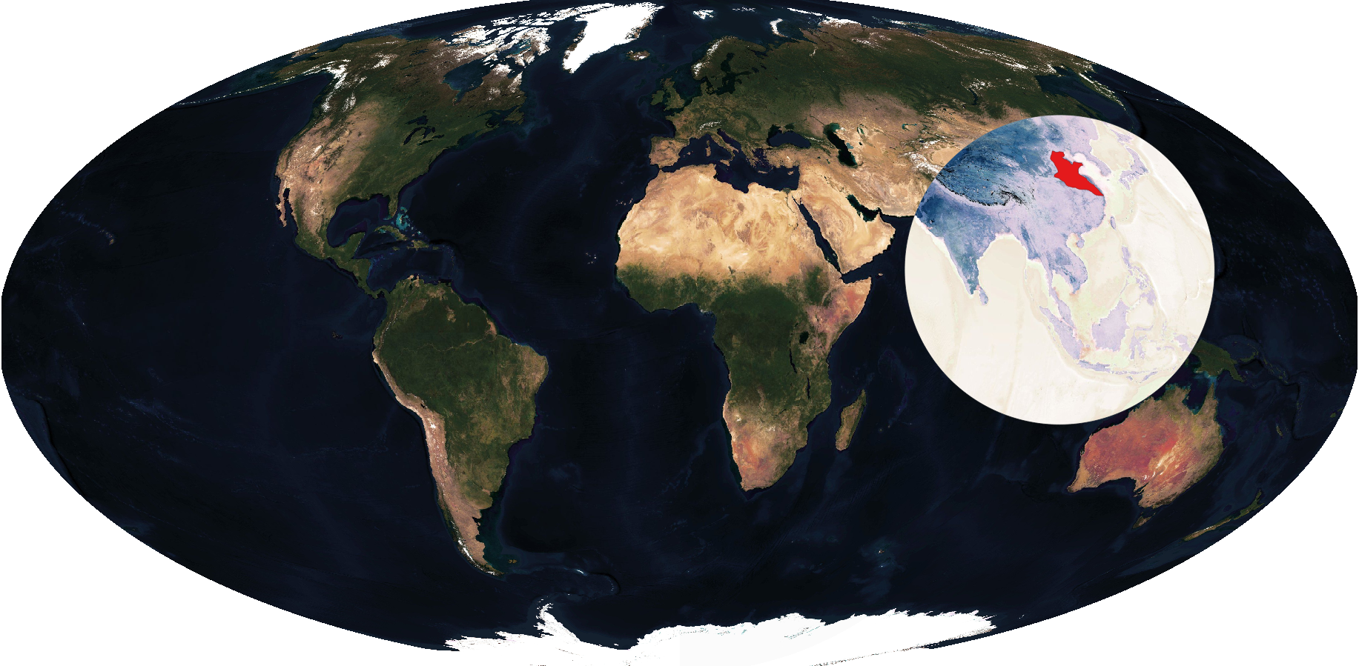
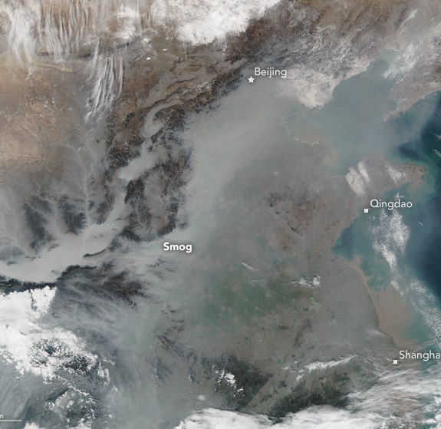
China Gigacity - A living lab for haze study
10% of global population
Beijing
Xi’an
Shanghai
Knowledge for global development, especially global south
Kulmala & Ding et al., 2021, ACP; MODIS
10/10

Slide 11
Open access, open data, open science
Access to research infrastructures
Access to data
Data today is heterogeneous and challenging to manage:
we need to organise:
  an easy access to the data
  plan harmonised and standardised ways to analyse it

Slide 12

Barriers of information
Data product
from a Research
infrastructure
Unknown data
Unusable
data
Wrong terminology
RI product
Discovery tools
No discovery
No PIDs
Authorization problems
Difficult licensing
No access
Difficult documents
Standard names
Assumptions of use
Discipline specific jargon
No understanding
No training
Unable to open
Unknown
format
No interface
No trust
Not understanding user needs
Standard licences
Lack of documentation

Slide 13
Science Diplomacy helps to answer global grand challenges
We need open science, open data to meet global grand challenges
  Without comprehensive data we are not able to meet the challenges
  Present and future questions
Geopolitics
  Barriers, problems
  To achieve open data is not easy or it is even impossible
  Science diplomacy could help
Science Diplomacy
  important tool to ensure open science, open data
  long-term, persistent networking
  Present and future questions/challenges
Trust – networks
High scientific level open doors

