Slide 1
Experience of use of FLEXPART atmospheric transport model for modeling of consequences of radiological accidents
Ivan Kovalets, PhD
Head of Department of Environmental Informatics and Atmospheric Modelling
Institute of Mathematical Machines and Systems NAS of Ukraine
Email: ivkov084@gmail.com

Slide 2
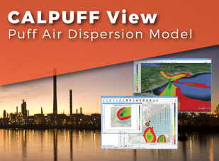




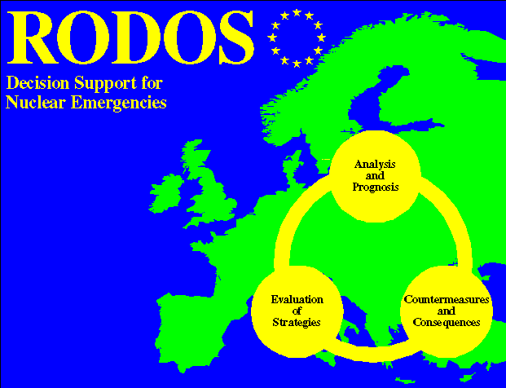
Introduction
Variety of models
Attempts to develop ‘standard’ model for different applications (radiological , air quality etc)
IAEA Gaussian model 1980
Model | Number of papers in SCOPUS
CALPUFF | 754
CMAQ | 2790
HYSPLIT | 2634
RODOS ADMs | 553
FLEXPART | 731
Notes:
In my talk I would like to tell about our diverse experience in use of Flexpart ADM in research, safety assessment studies, and for building real-time systems of analysis and forecasting of radionuclides
But before I start I want to make several general remarks.
Models are always therefore there are many models. This is true also for atmospheric dispersion models.
The slide shows the most popular of them. It does not include so-called coupled models, that describe 2way coupled meteorology and atmospheric chemistry.
The last three on the slide are the models used for radioactive air pollution. European decision support system actually has 4 models. Three of them (RIMPUFF, DIPCOT and LASAT) are for applications up to 800 km and one (Eulerian model MATCH) for long range transport.
Table shows number of papers in Scopus of each of the shown models. We see that…<Analysis: CMAQ – complicated chemistry and emission code SMOKE, Hysplit – web interface >
Because of variety of models there were always attempts to develop ‘standard model’. One of successful attempt of this kind was the so-called IAEA Gaussian model of 1980, which was then officially recommended in many countries for analysis of short-range atmospheric dispersion (up to 10, sometimes 30 km, with flat terrain and constant wind).
The situation became more complex for more complex conditions. For larger distances and travel times, and for complex terrain there was need in more complex models.
Attempts to make such models standard were only modestly succesfull.
1)This is because first of all, more complex models require much more data for their comprehensive calibration and validation.
2)Secondly, it is difficult to tune model for all range of conditions. For example, CALPUFF model, which was recommended by EPA for distances up to about 1000 km, appeared to be not the best in near-field applications, even though it had not restrictions in this respect.
3)Thirdly, many models are different by their underlying principles. Different models could have advantages in different applications.

Slide 3
Plan of the presentation
Overview of FLEXPART
Recent and ongoing experience
Simulation of atmospheric transport following Fukushima accident
Application for safety assessment regarding potential accidents at NPPs
Other related work
Use of FLEXPART for inverse source term estimation problems
Notes:
So, Flexpart – “one of the most widely used Lagrangian models” (Pisso et al., 2019), is the model which we will speak about.
This is one of the contemporary and quite complicated models. So we have to overview at first the underlying modeling approaches, and this will be the first part of my presentation
In the second part I will review the results of my studies to simulate atmospheric transport following Fukushima
<….and so on>

Slide 4
I. Overview of FLEXPART
(“FLEXible PARTicle dispersion model”) is a Lagrangian transport and dispersion model suitable for the simulation of a large range of atmospheric transport processes.
Developed by University of Vienna since 1998
Used in daily operations at the UN Comprehensive Nuclear-Test-Ban Treaty Organization (CTBTO)
Open source code distributed under GNU General Public license
https://www.flexpart.eu/

Slide 5
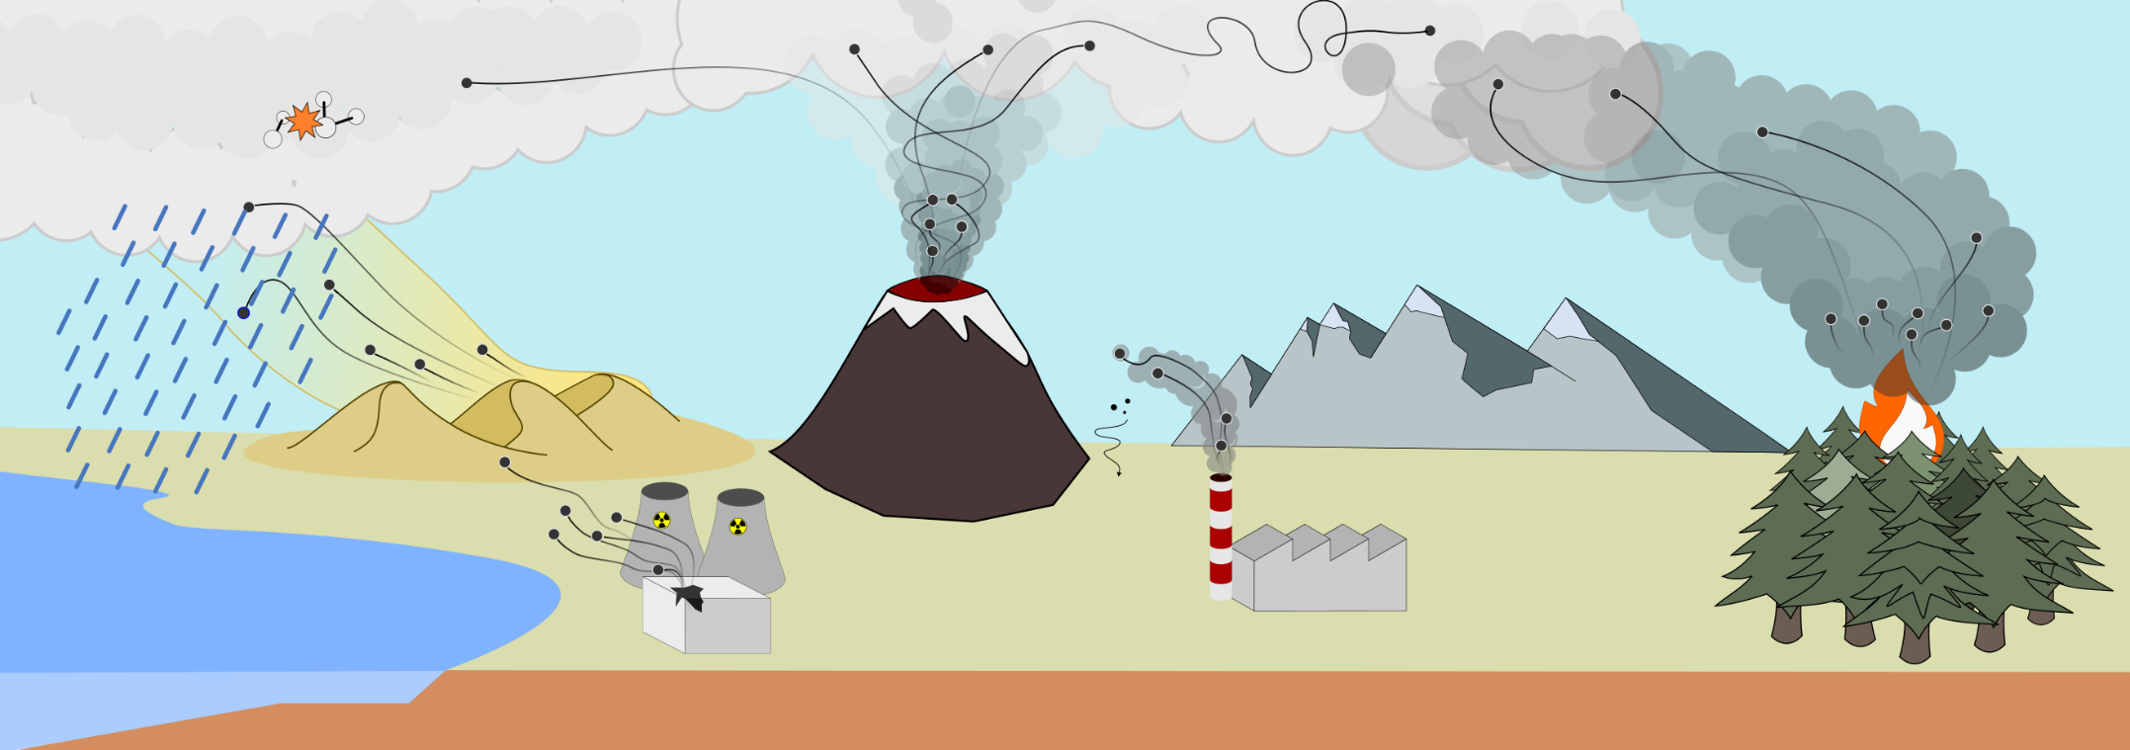
Basic capabilities
Advective transport and turbulent diffusion
Decay and linear chemistry
Dry and wet deposition
Backward mode
From local to global scale
Notes:
Apart from transport and turbulent diffusion, it is able to
simulate dry and wet deposition, decay, and linear chemistry;
it can be used in backward mode, with prescribed receptors in
It can be used from local to global scale.

Slide 6
Advection and dispersion
Particles advected by grid-scale wind+turbulent wind fluctuations+mesoscale fluctuations
Turbulent motions parameterized by Langevin equation
Langevin Eq. for vertical velocity accounts for ‘density correction’ proposed by FLEXPART developers
Micrometeorological variables (turbulent variances of wind speed etc) are parameterized basically using Monin-Obukhov atmospheric boundary layer theory and other works
Mesoscale wind fluctuations are also computed from Langevin Eq. but using grid-scale wind variance
Notes:
Dv_t(i)= ai (x, vt , t)dt + bij (x, vt , t)dWj
dWj are incremental components of a Wiener process with mean zero and variance dt , which are uncorrelated in time (Legg andRaupach, 1982)
Vertical velocity
Dw = −w*Dt/tauLw +DT*dsigw^2/dz + (1/po)(sigw^2 dpo/dz )DT +sqrt(2/tauLw)dW

Slide 7
Advection and dispersion (cont.)
Mesoscale wind fluctuations also computed from Langevin Eq. but using grid-scale wind variance
Vertical redistribution of particles by deep convection (due to unresolved vertical movements)
Particles splitting
Notes:
Dv_t(i)= ai (x, vt , t)dt + bij (x, vt , t)dWj
dWj are incremental components of a Wiener process with mean zero and variance dt , which are uncorrelated in time (Legg andRaupach, 1982)
Vertical velocity
Dw = −w*Dt/tauLw +DT*dsigw^2/dz + (1/po)(sigw^2 dpo/dz )DT +sqrt(2/tauLw)dW

Slide 8
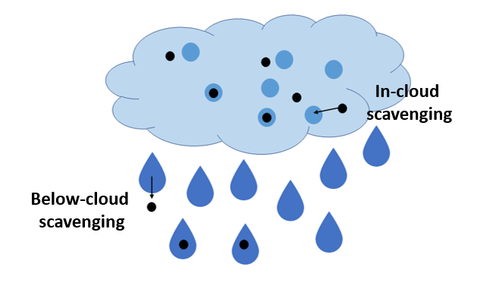
Depletion of the cloud – wet removal
Wet removal process:
1) below-cloud scavenging
2) in-cloud scavenging
https://nanofase.eu/show/scavenging_1589/

Slide 9
Depletion of the cloud – wet removal
Λ_{i} – scavenging coefficients, different for i=1 (below-cloud) and i=2(in-cloud)
For i=1 conventional parameterization: , I – precip. Intensity, d- aerosols’ size; A(d) is different for rain and snow
For in-cloud scavenging (i=2) - more complex relationships for Λ

Slide 10
Definition of the clouds and precipitation type in a grid cell
The simplest old method: RH>80% - cloud; else – no cloud;
If cloud water mixing ratio (CLWMR) available – more complex method
Precipitation type for below-cloud scavenging is simply derived from temperature: rain for t>0C; snow otherwise
For in-cloud fractions of both precipitation types are calculated from more complex relationships and input data and CLWM

Slide 11
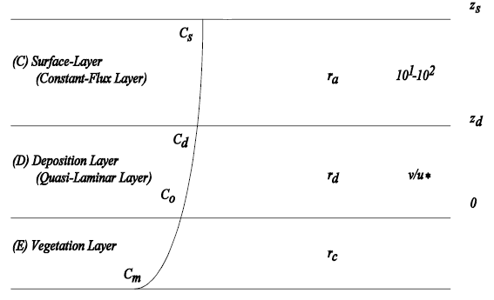
Dry deposition
Approach (common to many models)
Deposition by turbulence and interception - resistance approach
Gravitational settling (~d²)
Dry deposition affects particles below H=30 m (roughly corresponds to surface layer height in atmosphere)
Optional: setting dry deposition velocity by user
vd=(1/ra+1/rd) – if no gravitational settling
Figure from CALPUFF User’s Guide, showing layers of dry deposition, and corresponding resistances

Slide 12
Size distribution (SZ) parameters
All above parameterizations depend on the following parameters, which define size distribution (SZ)
Mean aerodynamic diameter, d [μm]
Geometric standard deviation, σ [nondimensional]

Slide 13
Backward mode
Runs model backward in time (option LDIRECT=-1)
Release produced in indicated places of receptors and for specified start and end time of measurement by respective receptor
Gridded ‘concentration’ fields correspond to the so-called ‘sensitivity’ or ‘source-receptor function’ (SRF)
SRF allows to evaluate concentration at the respective receptor for ANY source, coinciding with ANY of the computational grid nodes (or their arbitrary combination) without running model
More technical detail regarding backward mode will be provided later in this presentation

Slide 14
II. Simulation of atmospheric transport following Fukushima accident
Motivation
Two basic sets pf Cs-137 concentration measurements
  Many measurements at the territory of Japan
  more scarcy measurements worldwide
Rare (or no?) studies comparing model results with both sets of measurements
The same – regarding source term estimation (STE)
=>No models that are consistently good as compared to both set of measurements
(important especially in context of STE)

Slide 15
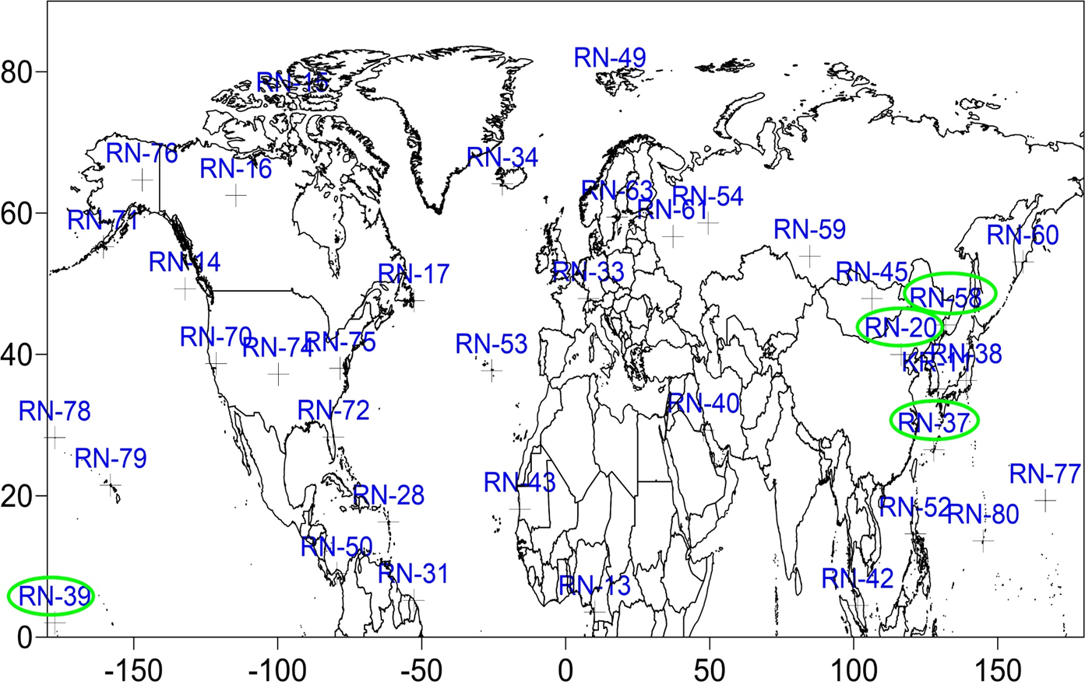
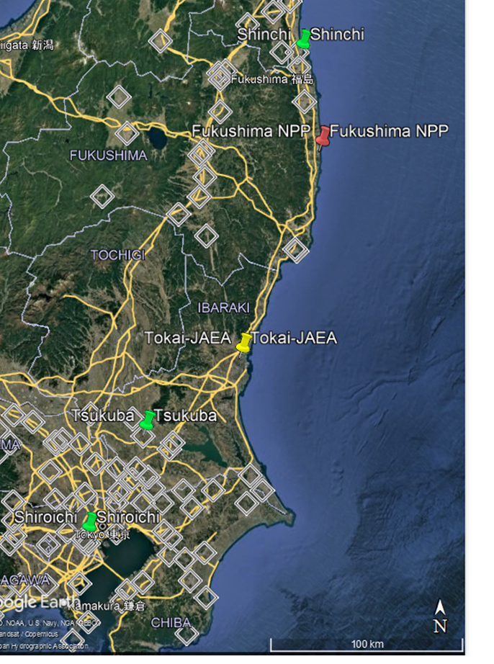
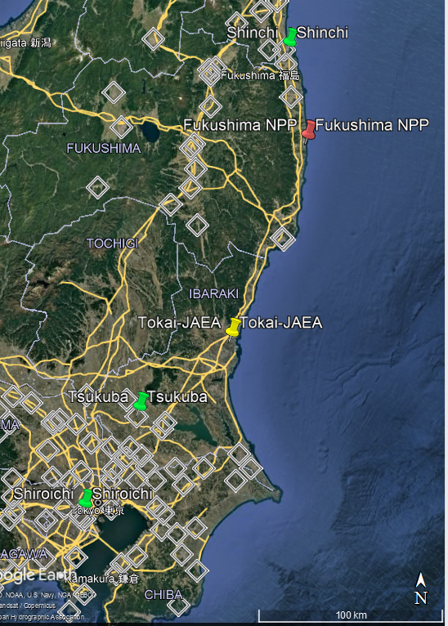
The goal of the study: to evaluate FLEXPART against both datasets
Locations of IMS CTBTO stations
. Locations of measurement stations in Japan (Oura et al., 2015)

Slide 16
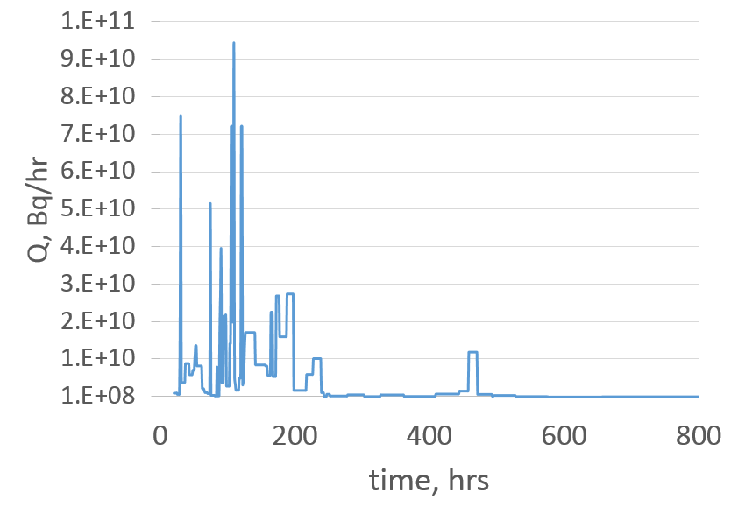
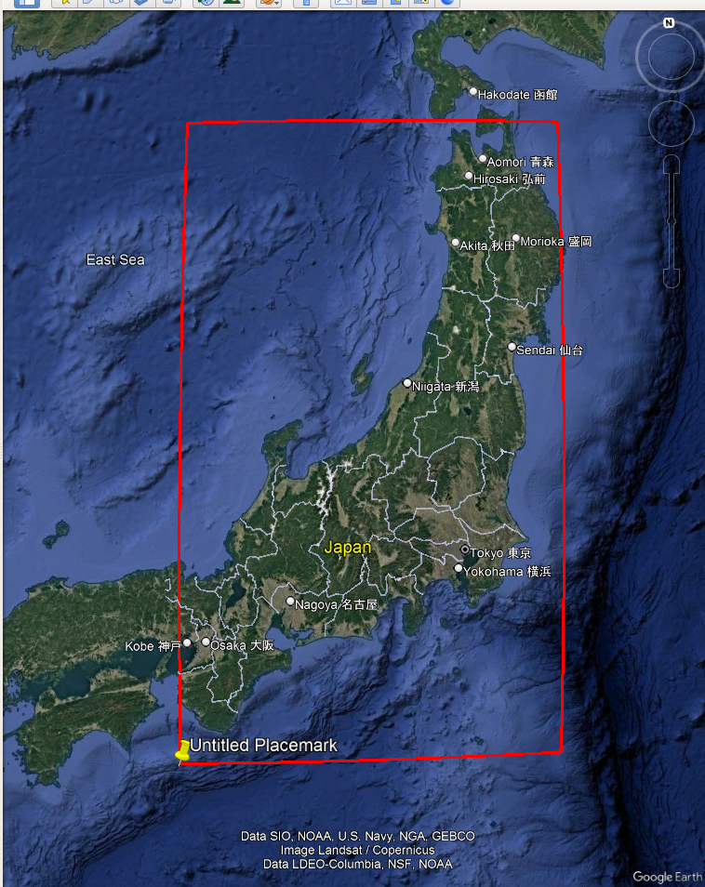
Input data
Source term by Terada et al. (2020)
Input meteorological data from NCEP GFS final analysis with 0.5 deg resolution
Output grid:
  covered the whole globe with 0.5 deg. res.
  Nested grid covered part of Japan with 0.05 grid. res
Release rate of Cs-137 according to Terada et al. (2020)
Time is in hours from 2011-03-11:00 UTC

Slide 17
Size distribution -initial runs
Same as in Van Leuven et al (2023) and others:
Mean aerodynamic diameter d=0.65 μm (in different other studies varied from 0.3 to 0.7)
Geometric standard deviation σ=3

Slide 18
Results
Acceptable in Japan (close to source), like this:
Largely overestimated in remote regions, like this:
(plume comes to Beijing only after hemispheric transport)

Slide 19
Attempts of parameter fitting
Increase of GSD up σ =10 to lead to improvement of results at remote stations, like this:
But led to deteriotation of results as compared to stations in Japan, like this

Slide 20
Size distribution – the problem
Data, from which SZ parameters were derived, summarized by Masson et al. (2013) contain only measurements,collected within plumes at far distances from the source and/or large travel times
SZ changes with travel time, because larger particles fall out faster
Part of Table from Masson et al. (2013) Env. Sci. Tech. 47 (19), 10995-11003

Slide 21
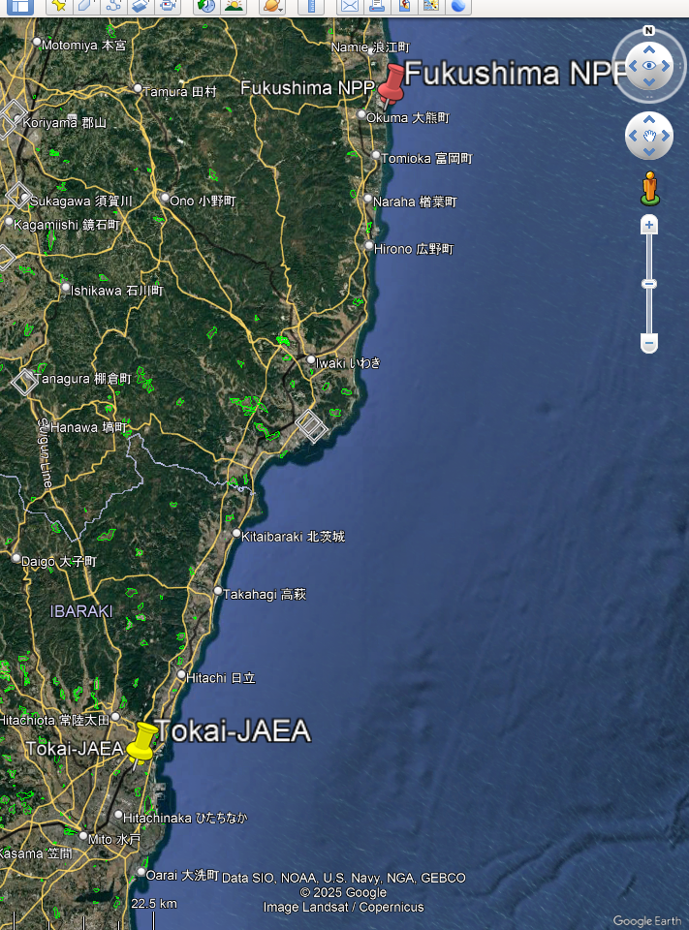
Measurement data by Miyamoto et al. (2014)
Collected during the accident, Mar 17-Apr 1, 2013
Place of collection: Tokai, Japan (111 km from Fukushima)

Slide 22
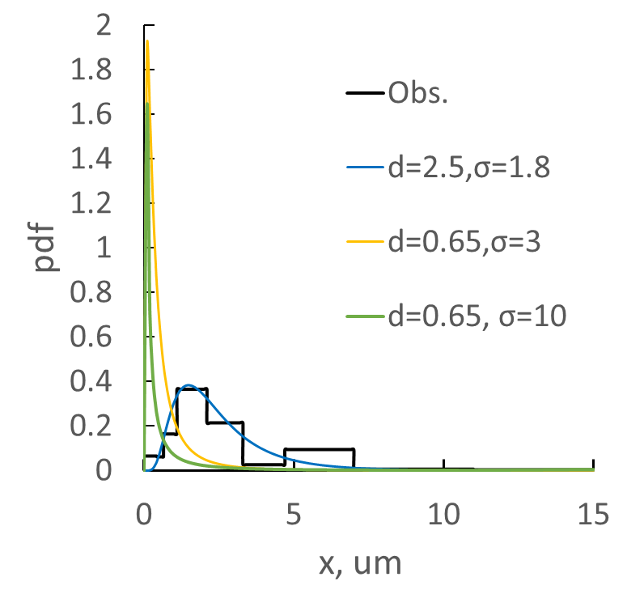
Curve fitting of measurement data by log-normal distribution

Slide 23
Input size distribution - summary
Parameters set | d, μm | σ | AMAD* | Ref | Meas. data
SZ1 | 0.65 | 3.3 | 0.35 | Van Leuven et al. (2014) | Masson et al. (2013)
SZ2 | 2.5 | 1.8 | 2.1 | This study | Miyamoto et al. (2014)
SZ1.1 | 0.65 | 10 | 0.05 | This study | Sens. test
*AMAD – Activity Median Aerodynamic Diameter

Slide 24
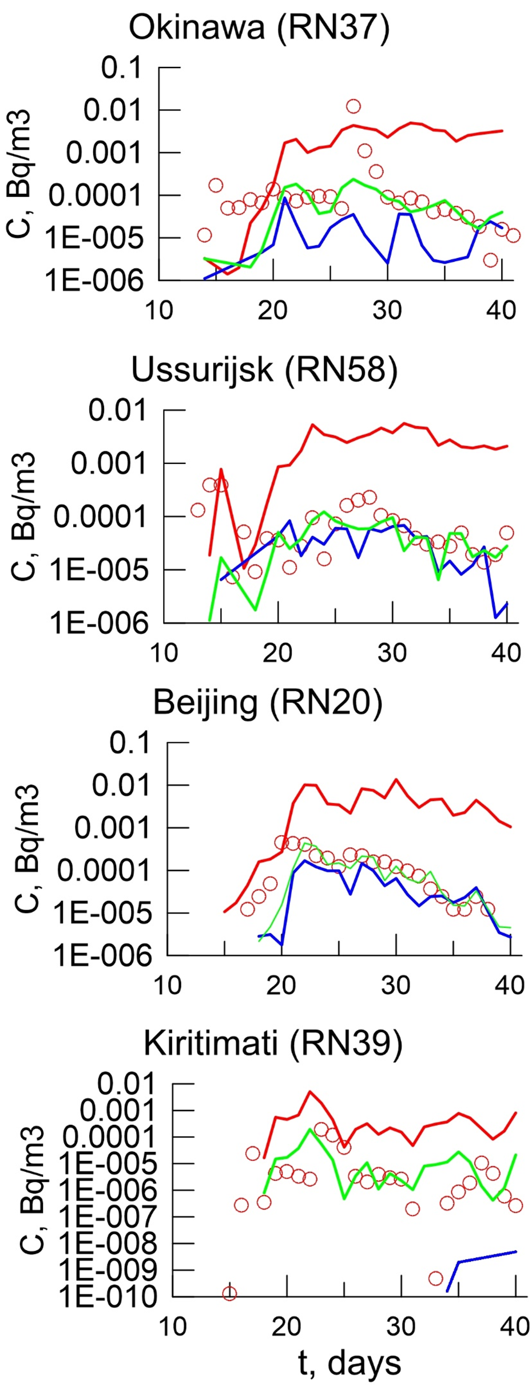
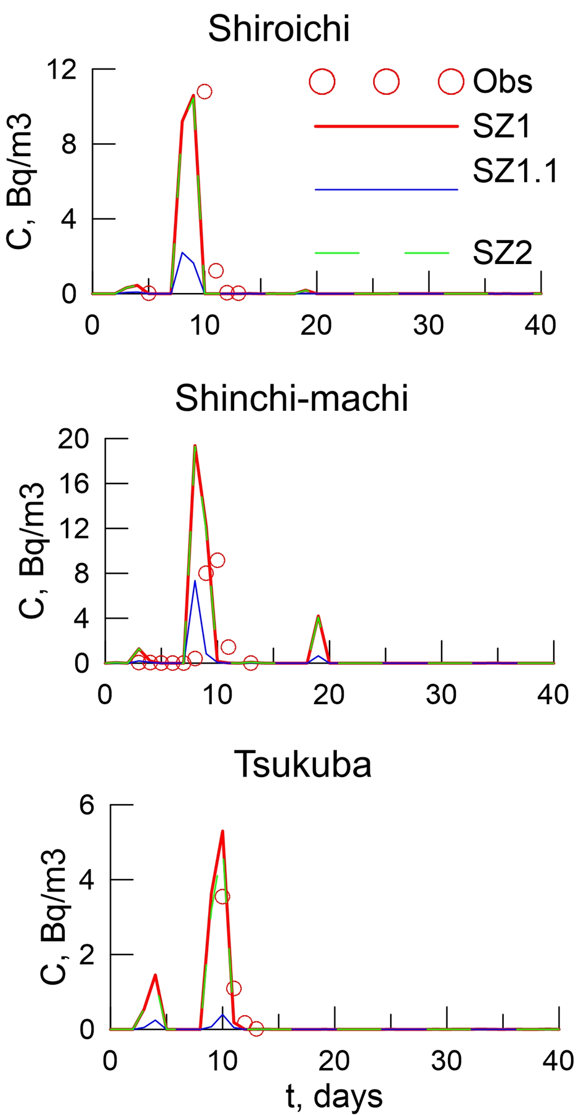
Results
Time plots for selected CTBTO stations:
Time plots for selected stations in Japan:

Slide 25
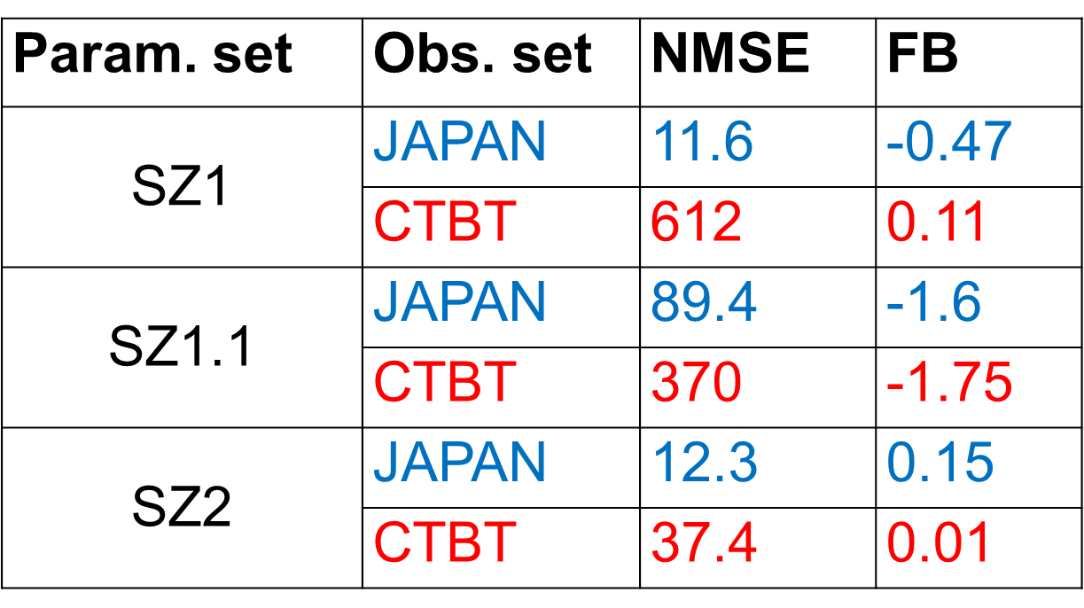
Statistical indicators of model errors
NMSE – Normalized mean squared error
FB – fractional bias

Slide 26
Conclusions from the study
FLEXPART-calculated concentrations of Cs-137 in air following the Fukushima accident are more consistent with both near-field and global measurements when the aerosol size distribution parameters in the source are derived from measurements taken in Japan during the event (d = 2.5 μm, σ = 1.8);
In contrast, when more conventional size distribution parameterizations—derived from measurements at remote stations or post-accident measurements in Japan, the calculated results at the remote stations are getting worse;
This suggests that the proposed aerosol size distribution parameters better approximate the true, though unknown, characteristics of the release;
Time change of size distribution within the plume could not be neglected in the process of estimating the corresponding parameters of the source term.

Slide 27
Remaining problems-1: Merging near-field and planetary dispersion
Meteorological data are coarse (0.5 deg.) for local zone;
Version of Flexpart that could use downscaled WRF data (FLEXWRF) is limited area model

Slide 28
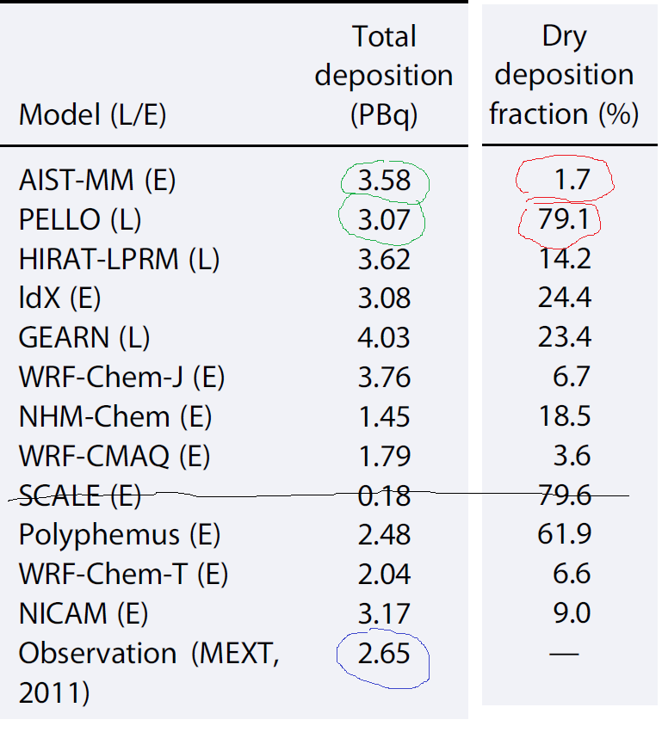
Remaining problems-2: Large uncertainty in wet and dry plume depletion and deposition calculations
Data in table obtaine with the same input meteodata
Even though total deposition calculated by all but one models agree with measured , the dry deposition fraction varies by factor up to 50!
So the effect of large compensating errors in wet and dry deposition is evident
Plume depletion errors related to deposition tend to accumulate with travel time
Modified table from Sato Y, et al (2018) J Geophys Res Atmos https:// doi. org/ 10. 1029/ 2018J D0291 44

Slide 29
Remaining difficulties-3
Need for re-evaluation of source term taking into considerations measurements both in near-field and far-regions, their possible correlations, meteorological variability (ensemble of meteorological fields) and uncertainties in size distribution
=> Example in part V of this presentation

Slide 30
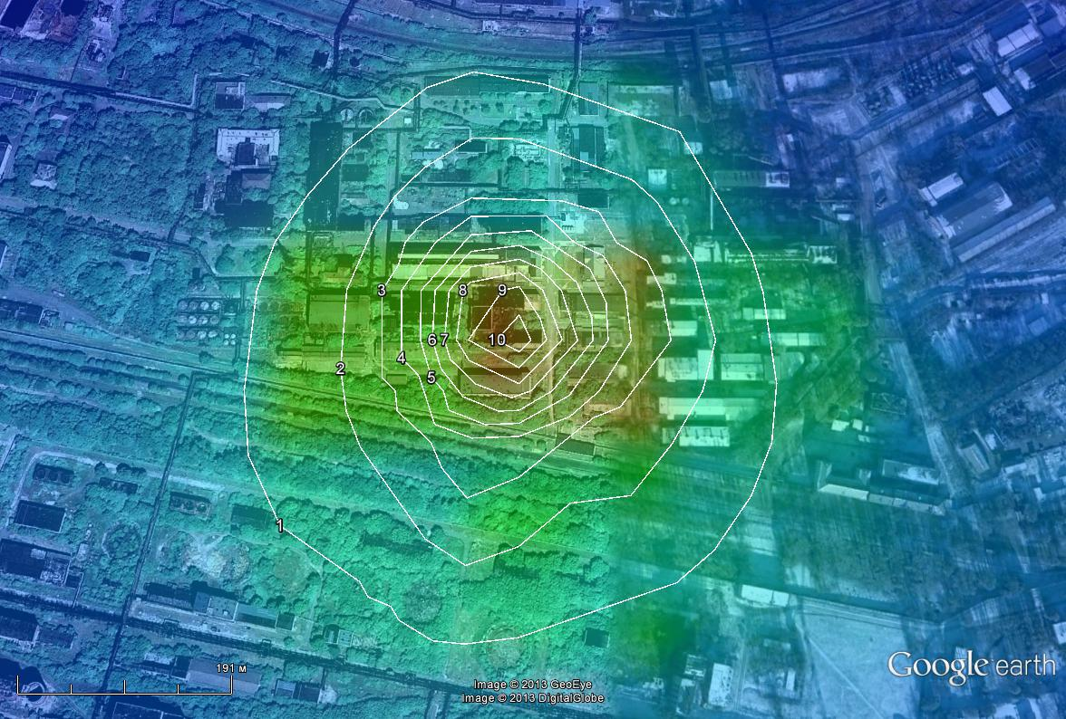
III. FLEXPART application for safety assessment regarding potential accidents at NPPs
Problem
1. for distances beyond a few tens km
wind rose approach to build risks maps is inappropriate
Example: evaluation of radiological risks in small domain regarding nuclear storage facility in Ukraine (former uranium processing plant PChP) using wind rose approach and simple model

Slide 31
Problem2: Old approach for risk evaluation regarding long range dispersion - classification of synoptic conditions, definition of ‘unfavorable conditions’
Example classifications of synoptic conditions regarding air pollution
Synoptic type | Consequences
Anticyclone, low wind | High airborne close to source
Periphery of cyclone | High concentrations far from the source
Stationary front | Large territory of contamination
Today may be used in air quality studies, especially for urban arias (source is spatially distributed), but considered outdated for radioactive air pollution following accidental releases

Slide 32
Modern approach
For the sufficiently long time period (1 yr or more) repeat the same release scenario but with different starting dates and using real meteorology
Statistically process results at points of interest to calculate probabilities of large dose values

Slide 33
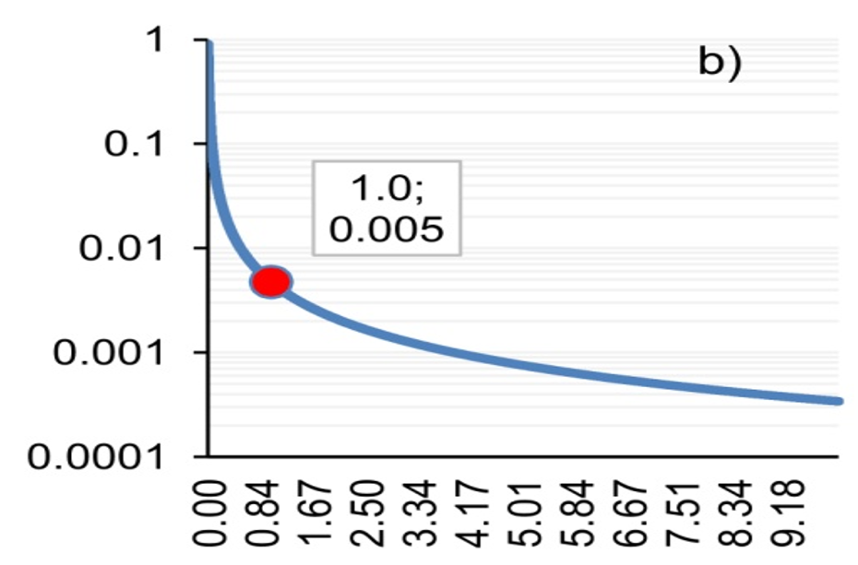
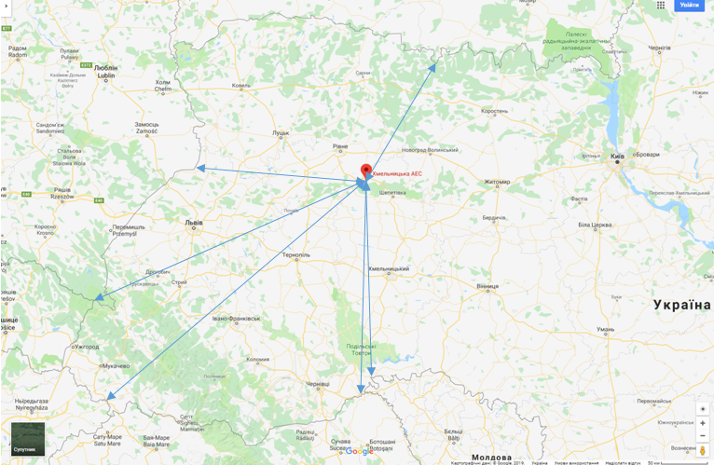
Example: dose assessment regarding consequences of potential accident at Rivne NPP in Ukraine for neighbor countries (using JRODOS )
GEV-fitted Conditional probabilities of exceeding a given dose provided that release happenned and among scenarios with non-zero doses (Poland)
Kovalets I., Romanenko O. (2021) https://doi.org/10.1007/978-3-030-58124-4_1

Slide 34
The goal of this work
to evaluate the statistical properties of the scenarios of heavy contamination of sea surface following hypothetical accidental release at one of the Korean NPPs and to classify the respective hazardous meteorological conditions.
to provide results for further dose estimates from water pathways

Slide 35
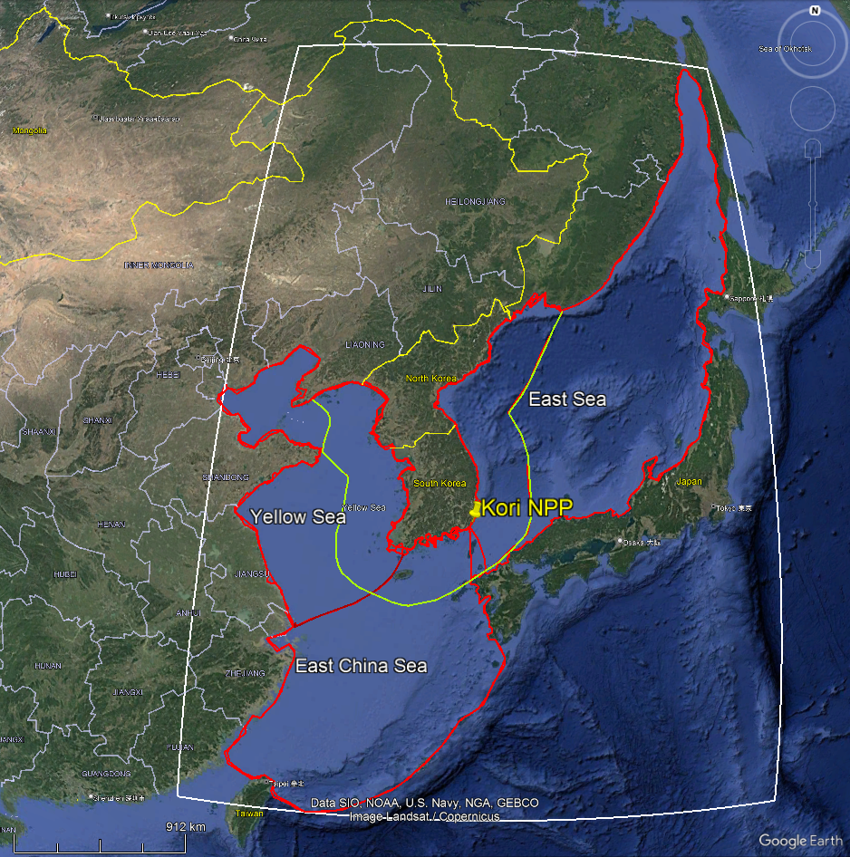
Region of interest: Northwest Pacific+East China Sea
Selected NPP:
Kori NPP considered as first example for being almost on the border of two seas ES and ECS

Slide 36
Source term
Shin Kori4 operates Advanced Power Reactor APR1400
(Pressurized Water Reactor - PWR)
Selected modestly heavy accident for APR1400 described by Uddin and Kim (2020)
Total emitted radioactivity of Cs-137 is 1E19 Bq
Duration of release: 13 h;
87% of emission – during first 3 h.
(typical time distribution for many other source terms for PWR reactors)
Height of release: uniformly distributed between from 0 to 300 m

Slide 37
FLEXPART model setup
Simulations covered 1 year from 1 Mar 2020 to 28 Feb 2021
Input meteorological data: NCEP Final Analysis, 0.5 deg. resolution
The accidental release was repeated every 6 h, thus in total Ntot=1640 different runs were performed
Simulation time period of single run: 120 hrs (sufficient for particles to leave comp. domain)

Slide 38
Output
Normalized deposition (wet, dry and total ) of Cs-137 on sea surface
Q – total emitted inventory
0≤Dr≤1
(possibility of generalization for other scenarios with other Q)
To be analysed separately for East Sea (ES), Yellow Sea (YS), East China Sea (ECS), and 200 km zone near Korean Peninsula

Slide 39
Results
Series of normalized deposition on surfaces of each sea for each run

Slide 40
Summary of the selected release scenarios with the highest depositions on the territories of ES, YS, ECS; the highest value of relative total depositions on different seas is highlighted in bold

Slide 41
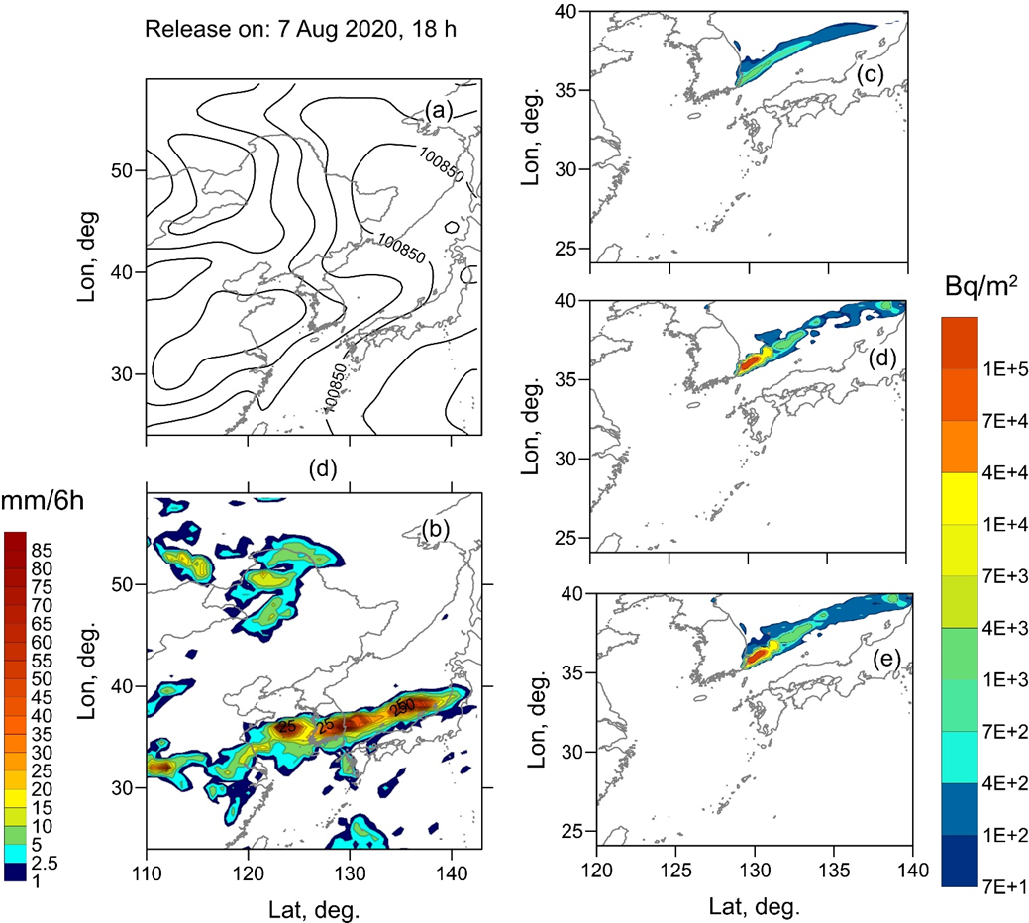
Weather and deposition maps for the scenario of release started 20200807:18 h UTC (synoptic system of monsoon rainband).
Maps of sea-level pressure (a), precipitation accumulated for 6 h (b), plotted for 20200808:00 h UTC; dry deposition (c), wet deposition (d), total (dry +wet) deposition (e) of Cs-137 plotted by the end of the simulation period.
Maximum deposition on ES

Slide 42
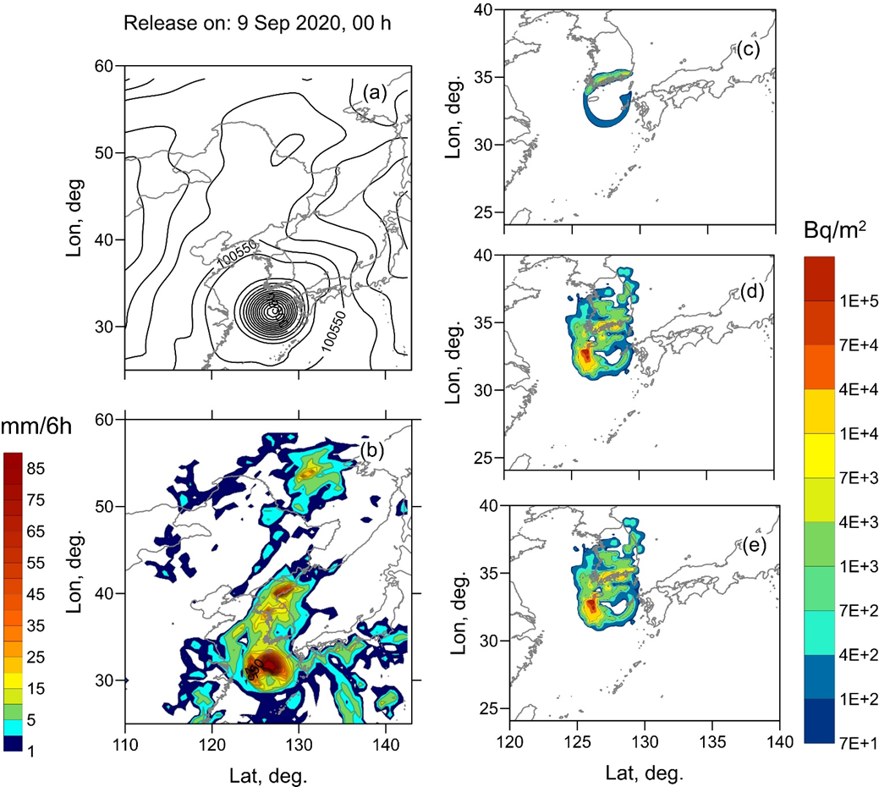
Weather and deposition maps for the scenario of release started 20200902:00 h UTC (typhoon).
Maps of sea-level pressure (a), precipitation accumulated for 6 h (b), plotted for 20200902:06 h UTC; dry deposition (c), wet deposition (d), total (dry +wet) deposition (e) of Cs-137 plotted by the end of the simulation period.
Maximum deposition on ES

Slide 43
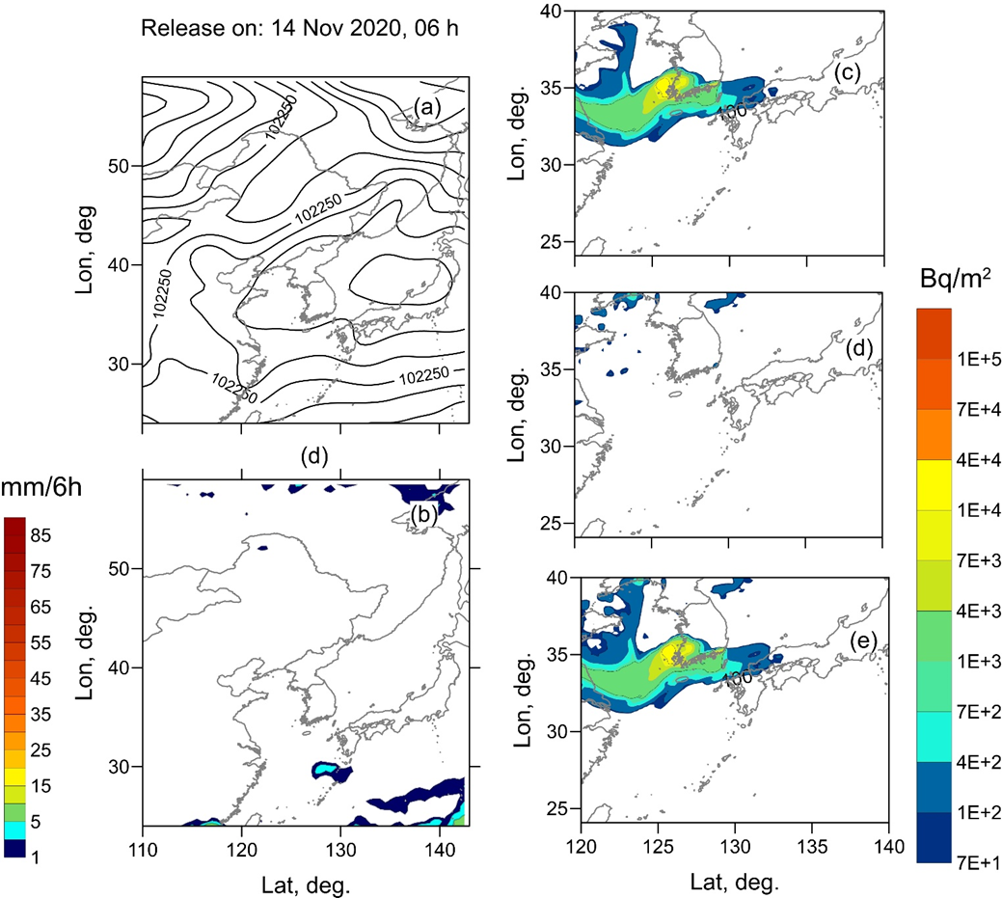
Weather and deposition maps for the scenario of release started 20201114:06 h UTC (high pressure system).
Maps of sea-level pressure (a), precipitation accumulated for 6 h (b), plotted for 20201114:12 h UTC; dry deposition (c), wet deposition (d), total (dry +wet) deposition (e) of Cs-137 plotted by the end of the simulation period.
Maximum deposition on YS

Slide 44
Basic statistical parameters of normalized deposition on sea surfaces

Slide 45
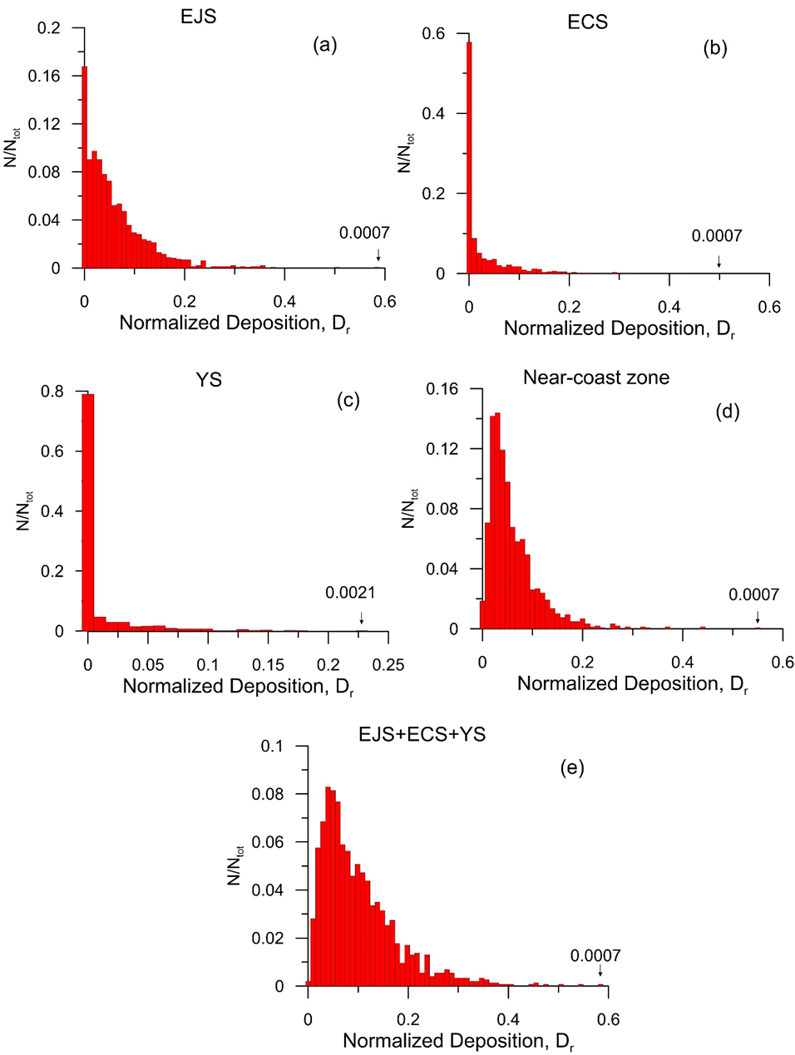
Probability histograms of normalized depositions on surfaces of different seas
Built with binwidth=0.01, plotted for ES (a), ECS (b), YS (c), near-coast zone (d) and ES+ECS+YS (e). The probability values and locations of the largest depositions are indicated by vertical arrows

Slide 46
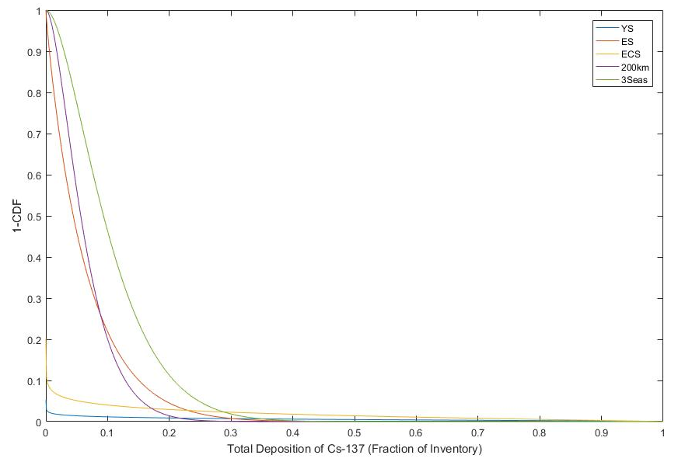
Fitted distributions
Complementary cumulative distribution functions ccdf(x)=1-cdf(x)=P(X>x) of normalized deposition on different seas obtained by integration of pdfs

Slide 47
Cluster analysis of meteorological conditions
Cluster analysis is a class of statistical methods that allows for ‘separating data into groups whose identities are not known in advance‘ (Wilks 2016)
Input data consisting a single observation vector (For each start time of release)
    sea-level pressure
    temperature at 850 mb
    precipitation intensities at the times 6 h after the start times of releases
    wet deposition and
    total deposition fields on the sea surface (ES+ECS+YS) by the end of simulation

Slide 48
Principal component analysis (PCA)
The observation vectors were then processed with PCA
PCA was conducted using the correlation instead of covariance matrix (Matlab pca function with options 'Centered'=true,'VariableWeights'='variance‘)
the first 510 principal components were responsible for more than 97% of the total variance.
only the coefficients representing the projection of the ‘observation’ vectors on the first 510 principal components were further processed by clustering methods

Slide 49
Evaluation of the number of clusters
Use of hierarchical clustering method, N
N=Ntot-s+1
Ntot=1460, numbr of simulated scenarios
s – being stage of hieararchical clustering process, at which minimal distance between clusters most rapidly increases

Slide 50
The number of clusters
s=1457
n=4
Evaluated number of clusters
(a) Minimum Eucledian distance D between clusters as a function of stage number s; (b) rate of increase of distance between clusters as a function of stage defined as Ds+1-Ds.

Slide 51
Clusterization with the specified number of clusters (n=4)
K-means method
After clusterization one of clusters consisted only 4 vectors (i.e. 0.2% of all vectors), while others – 99.8%.
So, clusters were merged into 3.
Clusterization in more components requires more vectors (i.e. more simulation scenarios and more than 1 yr period for simulation)

Slide 52
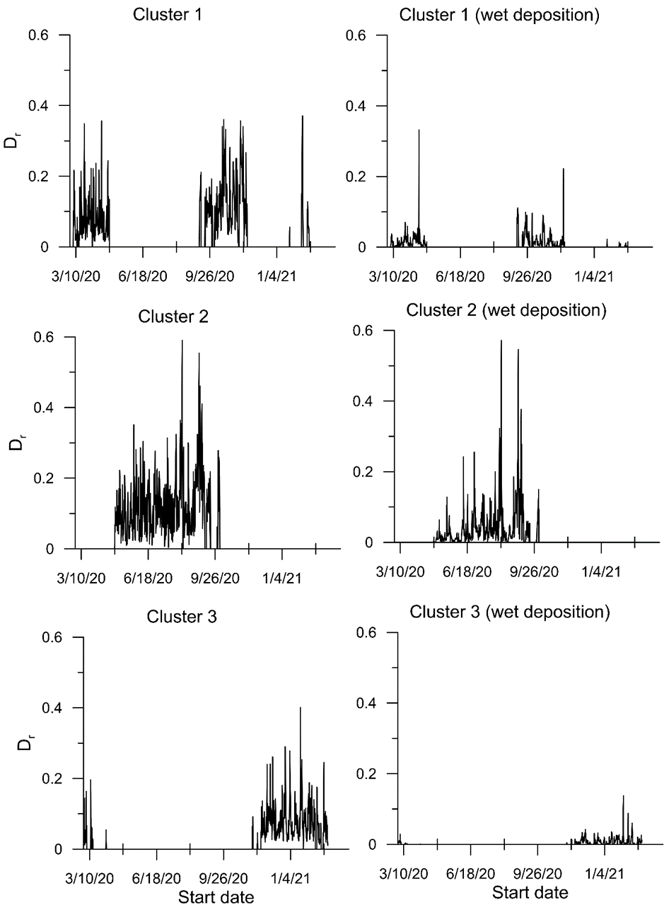
Normalized total deposition (left) and wet deposition (right) on the sea surface (ES+ECS+YS) for each of the 3 clusters.
Cluster 1 - spring and fall
Cluster 2 – summer
Cluster 3 – winter

Slide 53
Mean normalized depositions on surfaces of different seas for different clusters

Slide 54
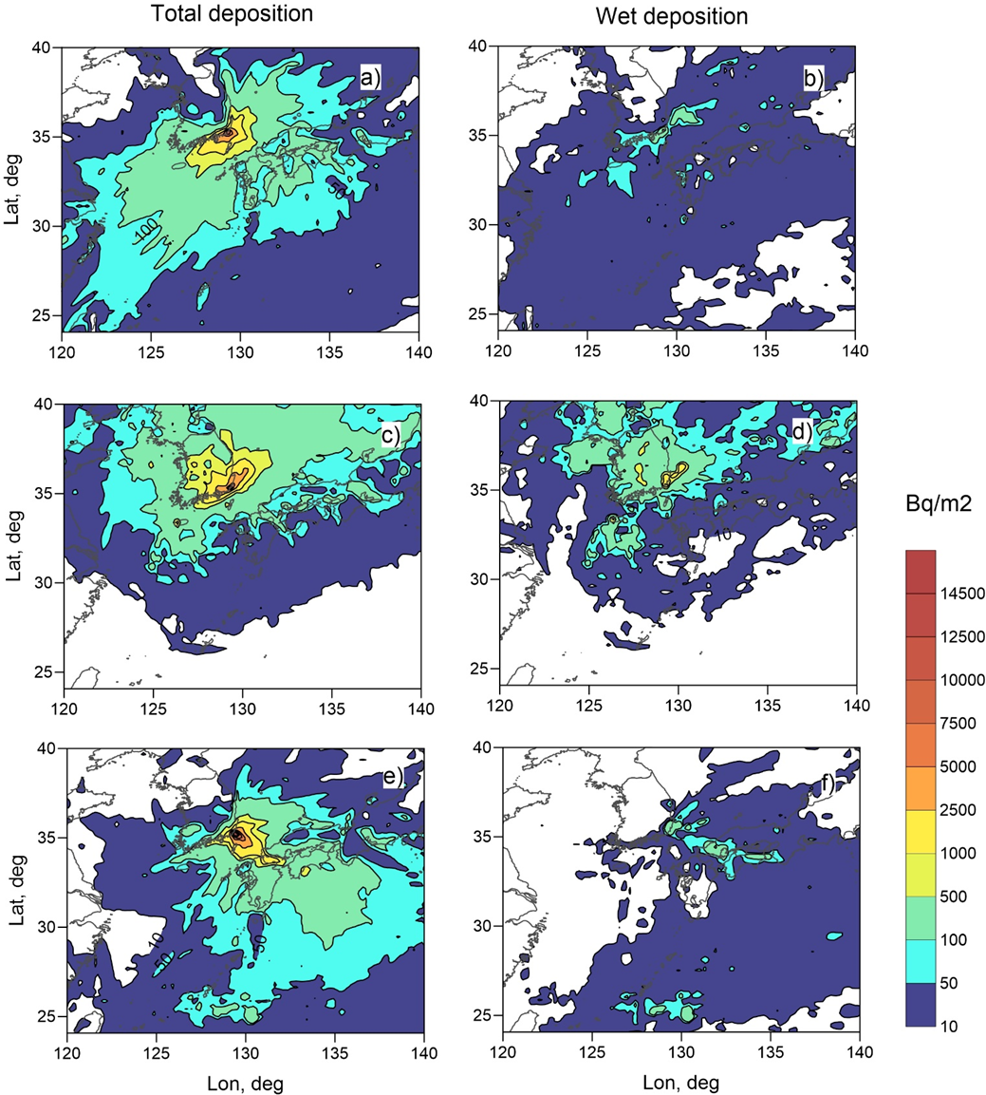
Average total (left) and wet (right) deposition for each of the 3 clusters:
a), b) – cluster No. 1 (‘Spring+Fall’);
c), d) – cluster No. 2 (‘Summer’);
e), f) – cluster No. 3 (‘Winter’).

Slide 55


Slide 56
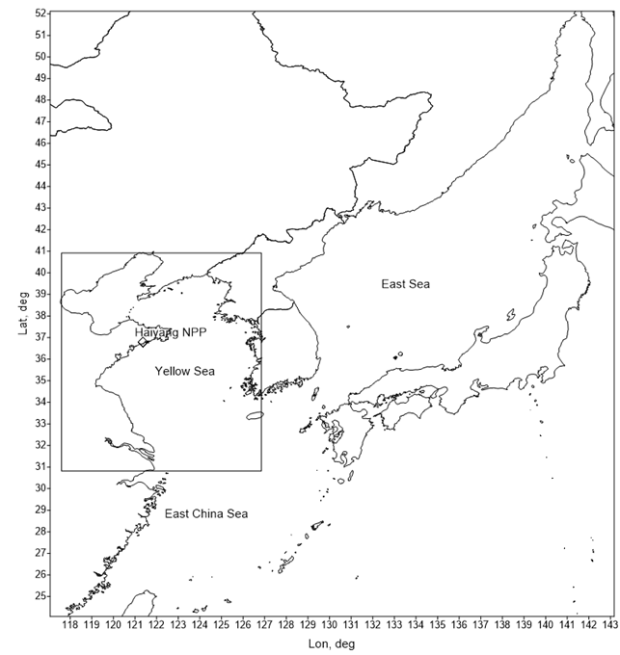
Study for Haiyang NPP

Slide 57
Statistical results of normalized depositon for Haiyang NPP
Statistics | Yellow Sea (nested grid) | Yellow Sea | East Sea | East China Sea | 200km | 3Seas | 3 Seas (results for Kori NPP) | 200 km (results for Kori NPP)
Fractions of inventory
Median | 0.05 | 0.055 | 0.0015 | 0.0015 | 0.0055 | 0.082 | 0.087 | 0.051
Mean | 0.072 | 0.072 | 0.011 | 0.018 | 0.023 | 0.097 | 0.11 | 0.066
Max | 0.47 | 0.46 | 0.26 | 0.36 | 0.35 | 0.53 | 0.59 | 0.57
Min | 0.0018 | 0.0007 | 0. | 0. | 0. | 0.0011 | 0.0036 | 0.003

Slide 58
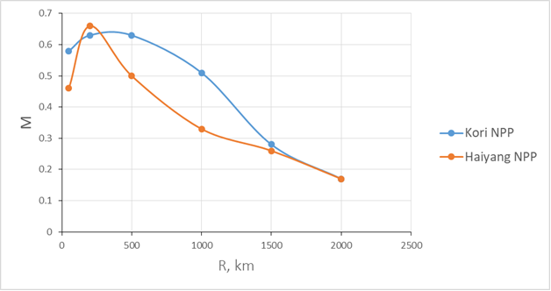
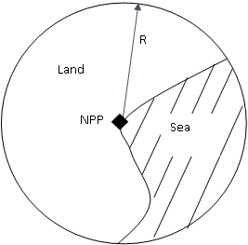
Analysis of differences between Kori and Haiyang NPP
Morphological parameter

Slide 59
Worst case scenario for YS (Haiyang NPP)
Maps of dry, wet and total deposition of Cs-137 for the scenario of release started 20201017:18 h UTC, plotted for end of simulation period
(synoptic system: low-gradient pressure field, periphery of pressyre high).

Slide 60
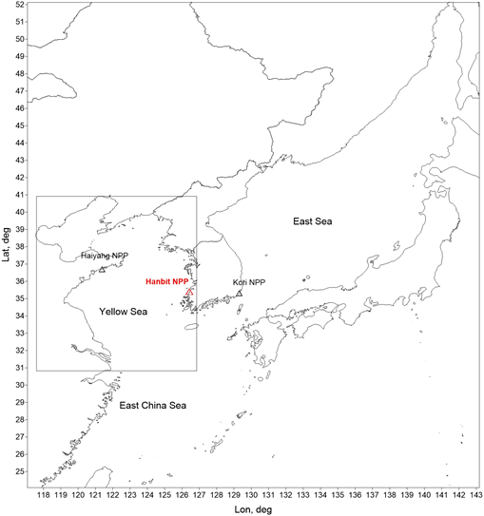
Study for Hanbit NPP

Slide 61
Source term
OP1000 reactor (PWR)
Source term – same as for Haiyang NPP
Worst case scenarios
Date:time (UTC) | Area | TotDep | Wet/Tot, %
20201111:00 | YS | 0.47 | <0.1
20200809:06 | ES | 0.33 | 98
20200409:06 | ECS | 0.47 | 21
20210210:18 | 200 km zone | 0.40 | 1
20200427:12 | YS+ES+ECS | 0.51 | 0.2
TotDep, (Hanbit)
0.47
0.26
0.36
0.35
0.53
Notes:
YS

Slide 62
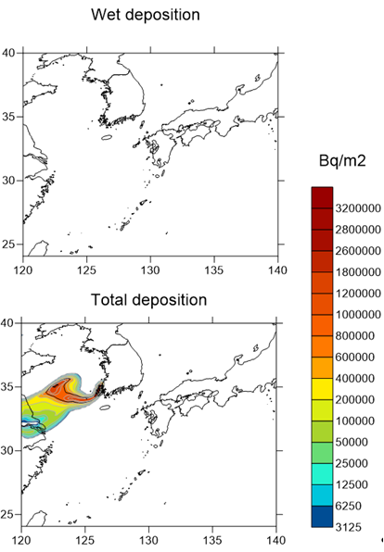
Worst case scenario for YS (Hanbit NPP)
Wet (upper) and total (bottom) deposition maps of Cs-137 for the scenario of release from Hanbit NPP started 20201111:00 h UTC, plotted by the end of the simulation period

Slide 63
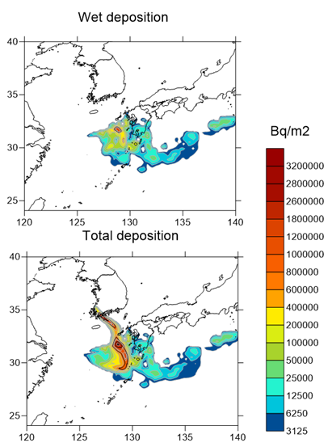
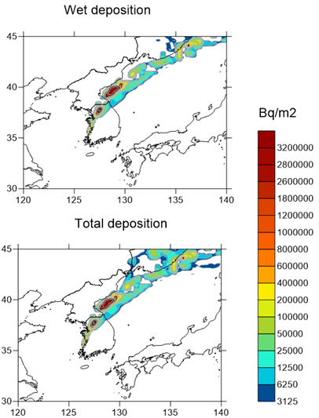
Worst case scenarios for ES and ECS, Hanbit NPP
Release from Hanbit NPP started 20200809:06 h UTC
Release from Hanbit NPP started 20200409:06 h UTC

Slide 64
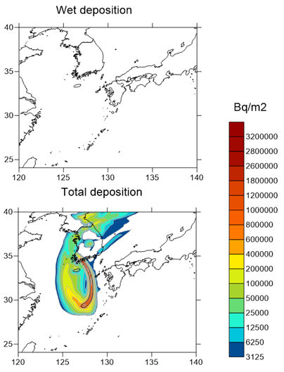
Worst case scenario for YS+ECS+ES

Slide 65
Comparing fallout from Kori, Hanbit, and Haiyang NPPs
For all 3 NPPs:
maximum deposition on YS is mainly dry deposition dominated, and it is result of plume entering low-gradient pressure field within high pressure system
Maximum depositions - on ECS, ES wet deposition is usually important, resulting from plume entering different kinds of low-pressure systems

Slide 66
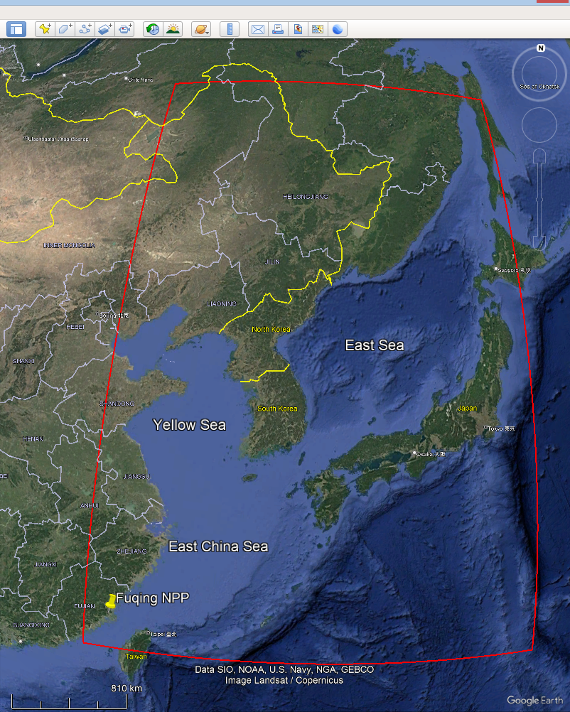
Fuqing NPP

Slide 67
Source term
CPR1000 PWRs
Difficult to find source term estimates for heavy accident
Mueller et al (2013) described heavy accident but provided only emitted fractions of inventories of nuclide groups were given

Slide 68
Source term
Finally after some processing and using additional data respective emissions of selected radionuclides were evaluated (INES-7 accident)
Time dependence provided by Mueller et al. (2013)
Cs-134, Bq | Cs-137, Bq | Ru-106, Bq
2.87E+17 | 2.49E+17 | 6.56E+16
Time, h | Caesium, % | Ruthenium, %
0-0.5 | 65.8 | 0
0.5-6 | 19.2 | 0
6-7 | 2.5 | 81.0
7-22 | 9.2 | 2.9
22-37 | 3.3 | 16.1

Slide 69
Worst case scenarios (all – summer monsoon)
Date:time (UTC) | Area | TotDep | Wet/Tot, %
2020062800 | YS | 0.17 | 96
2020072212 | ES | 0.17 | 99
2020082500 | ECS | 0.73 | 99
2020070512 | Near-coast zone | 0.19 | 82
2020082500 | YS+EJC+ECS | 0.77 | 96

Slide 70
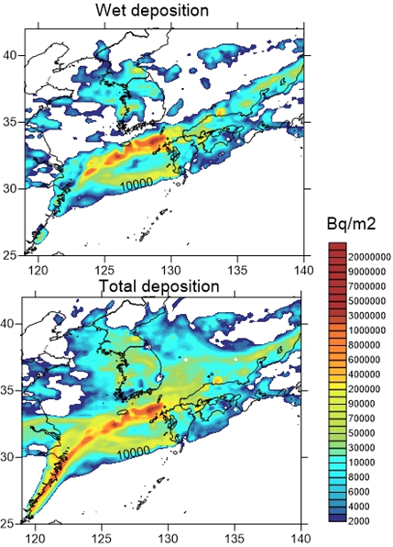
Worst case scenario for all seas
Release started 20200705:12 UTC
Wet and Total deposition of Cs-137 by the end of simulation period

Slide 71
Conclusions from the study
For the first time, the statistical properties of deposition on sea surface in the Northwestern Pacific following potential accidental releases from Kori, Haiyang, Hanbit and Fuqing NPPs were studied and classified
The deposition scenarios broadly are subdivided on wet-deposition dominated (mostly in summer) and dry deposition dominated, depending on synoptic pattern. Both kinds of scenarios could lead to heavy contamination of the sea.
YS is more prone to worst case dry deposition scenarios after accidents at Kori, Hanbit, Haiyang NPPs.
All worst case from Fuqing NPP happen during summer monsoon and are wet deposition dominated
For accidents at each of the considered NPPs the worst case scenarios lead to deposition from about 20% to about 70% of the emitted inventory on the area of one YS/ES/ECS
Probability distributions for each of the accident were built that allow to assess conditional probability of the respective scenario and thus to be used in risk assessment
Assessment of the radiological risks caused by the deposition of radioactive materials on the ocean surface following accidental releases requires a combination of the results of the atmospheric transport model with the ocean model, marine radioactivity transport model, and dynamical food-chain and dose model.

Slide 72
IV. Use of FLEXPART for inverse source term estimation problems
IV.1. Source term estimation applied for wildfires and dust storm in Chernobyl Exclusion Zone using ensemble method

Slide 73
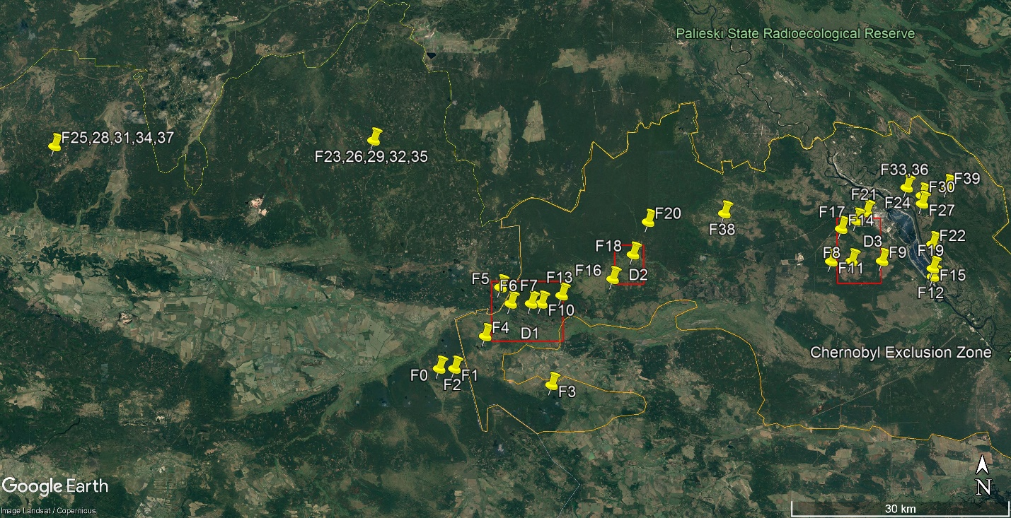
The most powerful in history wildfires in Chernobyl Exclusion Zone (ChEZ)
3-20 April, 2020, covered 30,000 ha in ChEZ , including the most contaminated parts of ChEZ like “Red Forest”

Slide 74
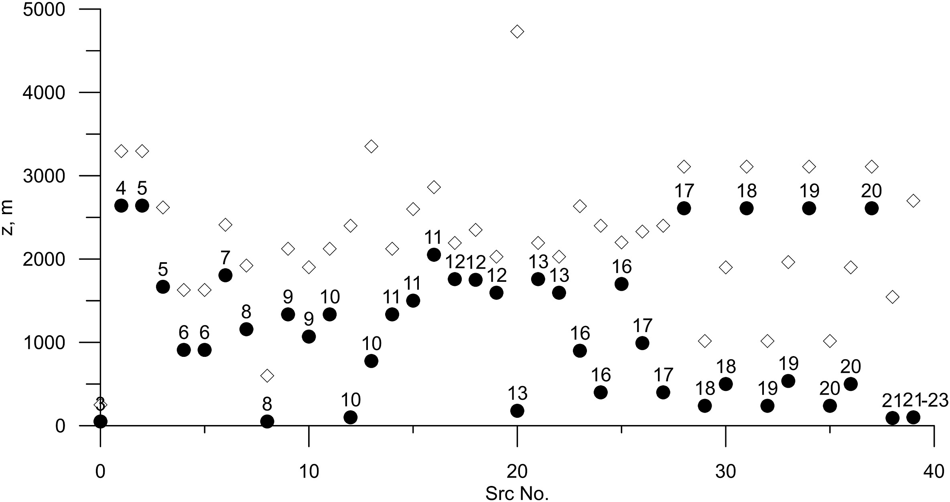
Heights of the bottom, (black circles), and upper (rhombus), boundaries of convective plumes for each of the wildfire sources considered in the study and derived from Global Fire Assimilation System

Slide 75
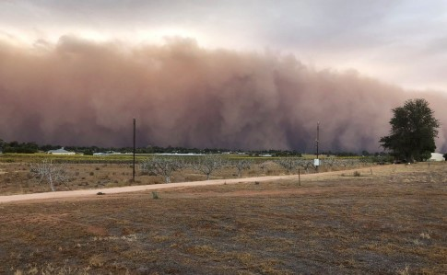
On 16-17 April wildfires were accompanied by dust storm that covered Northern Ukraine
- the first dust storm in this region in a few last decades according to State Emergency Service of Ukraine
The dust storm on 16 April 2020
Image source: https://www.pravda.com.ua/news/2020/04/17/7248378/

Slide 76
Stations that detected Cs-137 from wildfires

Slide 77
Different estimates of daily releases of Cs-137 from ChEZ
‘Evangeliou’ – Evangeliou et al. (2020) Sci. Rep.
‘Talerko’ – Talerko et al. (2021) Atm. Pol. Res.
‘Masson’ – Masson et al. (2021) Env. Sci. Tech.
‘FRP’ – from satellite data in this work

Slide 78
Reasons for discrepancies between emission estimates
Different approaches (satellite data, inverse problems)
Sensitivity to model parameters used:
  Background concentrations
  size distribution of particles
  Height distribution of releases
  Meteorological data
Lack of data to the East of ChEZ where plume was dominantly transported

Slide 79
Goals of this work
to take into account uncertainties of inexactly known parameters by developing ensemble source term estimation (STE) methodology
to evaluate emission inventories during wildfires in ChEZ together with their confidence limits
to evaluate of contribution of the dust storm in radioactive air pollution during this event

Slide 80
Ensemble Iterative Source Inversion Method (EISIM)
- Ensemble of estimates
- Nonlinear regression problem due to dependence of model error covariance matrix on solution q
Convergence of iterative method for one of realizations

Slide 81
Generation of ensemble: variable input data
Meteorological fields – 22 realizations in GEFS forecasts by NCEP
W_{h1} ϵ{0.1, 0.25, 0.5} fraction emitted between 0 and z_{bot}
W_{h2} =1-W_{h1} fraction emitted between z_{bot} and z_{top}
W_{sf1} ϵ{0.1, 0.2} wildfire emission: fraction of the size 1 µm
W_{sf8} ϵ{0., 0.2} wildfire emission: fraction of the size 8 µm
W_{sf16} =1-(W_{sf1} + W_{sf8}) wildfire emission: fraction of the size 16 µm
W_{sd1} ϵ{0.1, 0.4, 0.6} dust storm emission: fraction of the size 1 µm
W_{sd10} =1-W_{sd1} dust storm emission: fraction of the size 10 µm
In total – 792 ensemble members

Slide 82
Estimated emissions
Wind resuspension
(dust storm)
Wildfires

Slide 83
Range of NMSEs created by variable meteorology depending on other model parameters configuration
W_{sf0.25} =0.1
W_{h1} =0.5

Slide 84
Model vs obsevrations for ensemble average source estimation
NMSE = 4.2
r=0.85

Slide 85
Influence of different parameters on total variance
Size distributions in dust storms
Height distribution of emissions
Size distributions in wildfires
Average variations of total emissions δQφ caused by changing the input meteorological data (‘Meteo’), parameters of height distribution of the release (‘Wh’), parameters describing the size distribution of particles emitted by wildfires (‘Wsf’), and parameters describing the size distribution of particles resulting from wind resuspension (‘Wsd’); parameter λφ = δQφ/ΣδQφ is the relative value of δQφ summed over all variations.

Slide 86
Time integrated concentration of Cs-137 for the whole simulation period (3-27.04.2020)

Slide 87
Instantaneous concentrations of Cs-137
Kyiv
Kyiv
Kyiv
Kyiv

Slide 88
Concentrations of PM2.5 and Cs-137 in Kyiv
11 April, maximum Cs-137 concentration in Kiev
16-18 April, Dust Storm
PM2.5 measurement data from www.saveecobot.com, Cs-137 measurements: Masson et al. (2021)

Slide 89
Simulated plume on April 16 2020 created all sources (a) and by dust storm only (b)

Slide 90
Conclusions from the study
Ensemble iterative source inversion method (EISIM) was developed to properly take into account uncertainties in input data and model parameters in process of source term estimation.
The estimated total emission of Cs-137 from wildfires was close to the first guess estimations: 450 GBq vs. 586 GBq. The confidence interval of the emitted inventory is large: from 45 to 1330 Gbq.
The obtained estimates of the respective total emission due to wind resuspension during dust storm: 25 GBq with the upper confidence limit 106 GBq, significantly less than the respective first guess emission (162 Gbq).
Dust storm, being order of magnitude less powerful source of radioactivity than wildfires created comparable or greater pollution over wide region over large areas
The meteorological input data has the most significant impact on the variability of the total emission inventory, it explains about 50% of the variance; height distribution parameters explain 26% of the variance; size distribution; 16% of the variance
Method EISIM could be used also in STE problems related to other accidents such as Fukushima

Slide 91
More detal:

Slide 92
IV.2 FLEXPART-based pilot system for possible sources of radioactive air pollution analysis using inverse modeling
Kovalets et al. (2025). Lecture Notes in Networks and Systems, Vol. 1391, pp.1–14, https://doi.org/10.1007/978-3-031-90735-7_1 (in press)
92
Notes:
Good afternoon, everyone. First, I would like to thank the organizers of the event for the opportunity to speak today.
My name is Roman, and I am a Researcher at Environmental Science scientific department, at the Institute of Mathematical Machines and Systems Problems of the Ukraine National Academy of Science.
The topic of my presentation is “Pilot system for possible sources of radioactive air pollution analysis using inverse modelling.

Slide 93
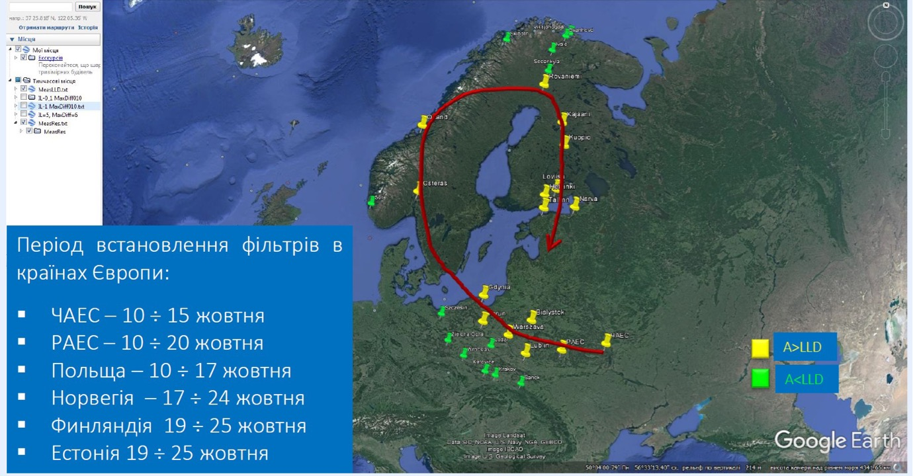
An Actual Example
Detection of radioactive contamination iodine-131(I-131) of unknown origin in 2016 over Europe
93
Notes:
[4]
A real-world example is the detection of radioactive contamination by iodine-131 of unknown origin in 2016. This pollution has been detected at many European stations from Ukraine to Norway with different levels of concentration at various periods. The yellow markers on the displayed map indicate the stations where contamination was observed, exceeding the lower limit of detection (LLD), which represents a significant area across Europe. While many stations reported increased pollution levels of iodine, the exact location of the accident remains unknown. The concentration of pollutants near the accident's source could pose serious risks to both the population and the environment. Consequently, we are facing the challenge of identifying the source of the unknown emissions.
LLD -> Lower Limit of Detection (file СППР-2017_Romanenko_etal.doc)
Despite iodine detection by many stations, the origin of the radionuclide was unknown.

Slide 94
Source inversion – is the process of estimating source parameters, such as source location, intensity, and release timing, by minimizing a cost function that measures the difference between calculated and observed values.
94
Notes:
[5] To identify the pollution source, a series of reverse simulations were conducted to determine probable emission regions. Source inversion is a technique used to estimate unknown source parameters — such as location, intensity, and timing of release — by minimizing a cost function that measures the difference between calculated and observed values.

Slide 95
The Purpose Of The Work
Development of a pilot version of a system for analyzing unknown sources of radioactive atmospheric contamination in cases where they are detected by monitoring networks.
95
Notes:
[6] So purpose of the work is to develop a pilot system to analyze unknown sources of radioactive atmospheric contamination when they are detected by monitoring networks.
З цього випливає мета нашої роботи - це розробка

Slide 96
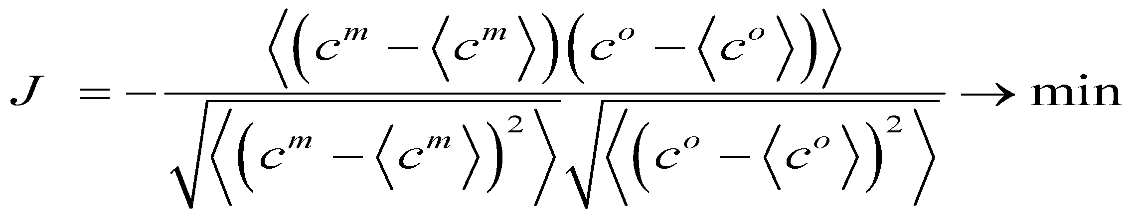
Problem of inverse modeling
Minimization of the correlation-based cost function
where c^{m} –is the concentration calculated by the atmospheric transport model, cº – is the observed concentration
96
Notes:
[7] To locate the source, we use an algorithm that minimizes the correlation-based cost function by identifying source coordinates that yield the lowest possible value. Inverse modeling involves estimating source parameters, such as location, intensity, and release timing, by minimizing this cost function.
< > - усереднення cі в степені м
Cm – вектор розрахованих концентрацій, а Сo – вектор виміряних концентрацій
Функція якості – це коефіцієнт кореляції між розрахованими і виміряними концентраціями, взятий зі знаком мінус “–”
За умовою апроксимації постійної інтенсивності джерела, або залпового викиду, розраховані значення ФУНКЦІЇ ЯКОСТІ J не залежать від обсягів викиду Таким чином, її використання дозволяє розділити задачу на два етапи: на першому етапі мінімізація (6) дозволяє встановити просторове місцезнаходження та часові характеристики дії джерела, а на другому етапі – визначити обсяги викидів.
Алгоритм мінімізує функцію якості (шукає такі координати джерела які дають їй мінімум).
Шукаємо такі координати джерела при яких функція досягає мінімуму.

Slide 97
Probability density function of source location (θ)
Probability P of source to be located within isoline of r=r_{P}

Slide 98
How to evaluate concentration in measurement points for every possible source? (Adjoint equations)
Let concentration field c(x,y,z,t) is described by advection-diffusion equation
Let c_{O}(n) is n-th measurement taken in point: during time interval:
Let p_{n} is ‘probe function’ such that:

Slide 99
Then solve adjoint equation:
Then model concentration corresponding to measurement n could be evaluated from the relationship:

Slide 100
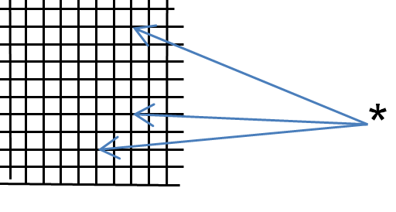
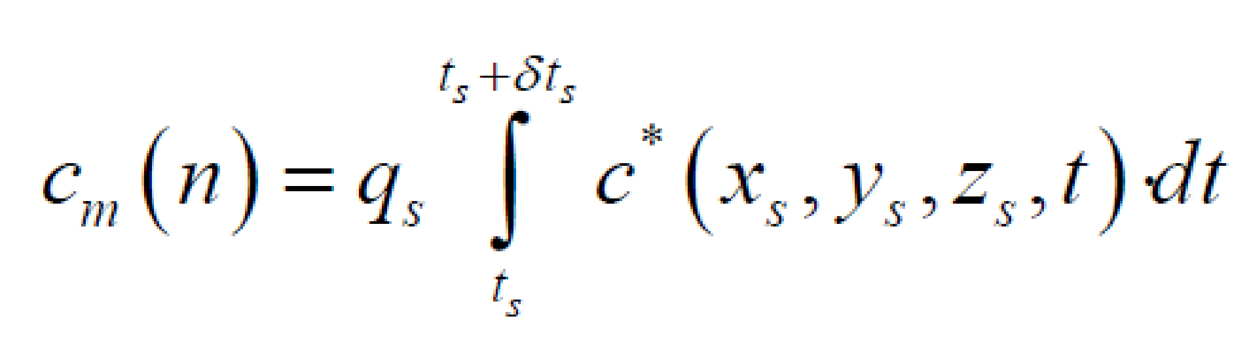
Backward mode for FLEXPART calculations – sensitivity function с* (source-receptor) on the calculation grid
C* - ‘concentrations’ (actually sensitivity fields) calculated by FLEXPART in backward mode for a given receptor
с*
n-th observation- single source for adjoint eq.
Caution: In practical applications of FLEXPART, equation is approximate
100
Notes:
To minimize the cost function, we need to assess model values for various source coordinates. This can be done through two approaches:
Direct calculations for each possible source location, which is computationally intensive, requiring thousands of model calculations.
OR reverse in time mode calculation, in which a sensitivity function is computed. The last one we used in our work. And Flexpart already has implementated backward in time mode. **So it allows us to calculate sensitivity function for each source location.**
The sensitivity function is determined by performing a unit release from each station that detected the contamination, with the model simulating its spread opposite to the prevailing wind direction. This approach helps identify the region from which the contamination could have reached that station.

Slide 101
Stages of inverse modeling
- Evaluation of correlation function for source assumed in every grid node
- Evaluation of release start time and duration in grid nodes, which fall in the region of high probability of source location
- Evaluation of emitted inventory
101
Notes:
[8] The main stage of inverse modelling include: Evaluation of correlation function for source assumed in every grid node; Evaluation of release start time and duration in grid nodes, which fall in the region of high probability of source location, And Evaluation of emitted inventory.
Probability density function of source location is assumed to be proportional to correlation function.
Основні етапи зворотнього моделювання:
- Оцінка кореляційної функції для джерела, прийнятого в кожному вузлі сітки
- Оцінка часу початку викиду та тривалості у вузлах сітки, які потрапляють в область високої ймовірності розташування джерела
- Оцінка викинутих запасів

Slide 102
SIMFLEX code
Solution of STE was implemented in Fortran code SIMFLEX (Source Inversion Module-FLEXPART):
Reads sensitivity functions from FLEXPART output
Reads measurements data.
Minimises with respect to source location and evaluates the spatial distribution of probability density function for source location
For the subset of nodes in which probability of source location exceeds threschold value the time parameters and inventories of release are evaluated by minimization of the cost function.

Slide 103
Algorithm or model chain
Input data
Output data
Meteorological fields
FLEXPART
Sensitivity function (С*)
Coordinates of radiological stations
and measurement times
User data
SIMFLEX (minimization)
Probability maps of source location, time, volume of emissions
Measurements of radiation pollution
103
Notes:
[11] The algorithm of the system is as follow:
the user enters the measurement data of radiation pollution, coordinates of radiological stations and measurement times.
Based on that data we load meteorological fields and start Flexpart calculations to find sensitivity function.
After all flexpart calculation finished we start minimisation(simplex) and at the finish we will receive probability maps of source location, release start time and volume of emissions.

Slide 104
Application Example
104
Notes:
[13] Let’s now look at an example of how a system can be utilized.

Slide 105
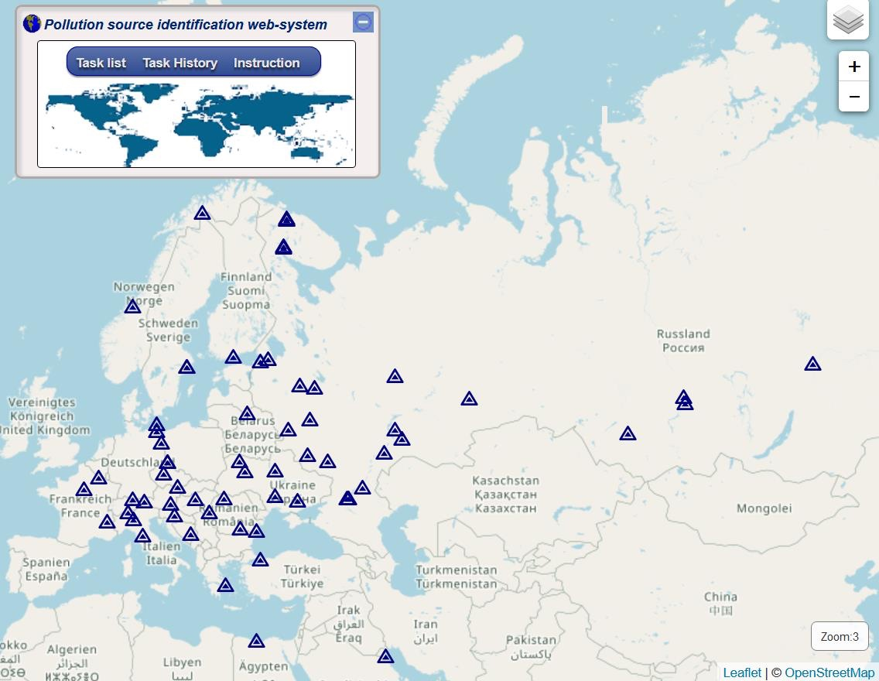
Modeling the source of Ru-106 entered the atmosphere in 2017
Radiological measurement stations (triangles) that detected Ru-106 in the atmosphere were conducted from September to October 2017. The sampling duration varied from 12 hours to 2 weeks, with a total of 118 measurements.
105
Notes:
[14] As a test case, we used a real-world event involving the detection of ruthenium.
Ruthenium is not found in the environment; it originates exclusively from human activities. This artificial radionuclide is produced as a byproduct of the nuclear fuel cycle. Therefore, if ruthenium is detected in the atmosphere, it indicates that a nuclear-related event or release has occurred. As we can see, Many stations recorded this event across Eurasia, covering areas from Kuwait to Norway and from the English Channel to Mongolia. Detecting a radionuclide not present in nature by many stations means that something bad could have happened, so it is important to find the source of the emission.
We used the developed system to determine the possible source of the emission.
On the left we can see the window of our system where the blue triangles are location of the monitoring stations that detected pollution.
It does not exist in nature it only could be anthropogenic origin. Detection covered full Eurasion as we see from figure.

Slide 106
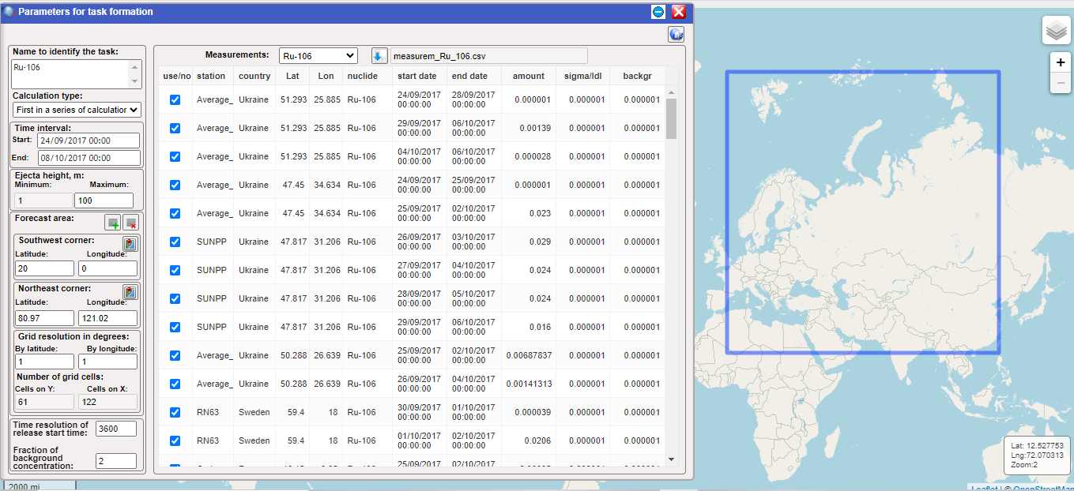
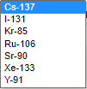
Entering the input data of measurements
106
Notes:
In this slide
we can see the input data window, where the map on the right shows the modeling area where we search for the emission source. The main input data include station coordinates, measurement period, concentration in Becquerels per cubic meter, instrument error (sigma), and background values.

Slide 107
Output results
1. Sensitivity functions for measurement points;
2. Normalized correlation function;
3. Calculated start time of the release in hours from the beginning of the calculation;
4. Calculated duration of the release in hours;
5. Total released mass in Becquerel.
Notes:
After completing the calculations, we can obtain the following types of indicators:
Sensitivity functions for measurement points;
Normalized correlation function; Calculated start time of the release in hours from the beginning of the calculation; Calculated duration of the release in hours and Total released mass in Becquerel.

Slide 108
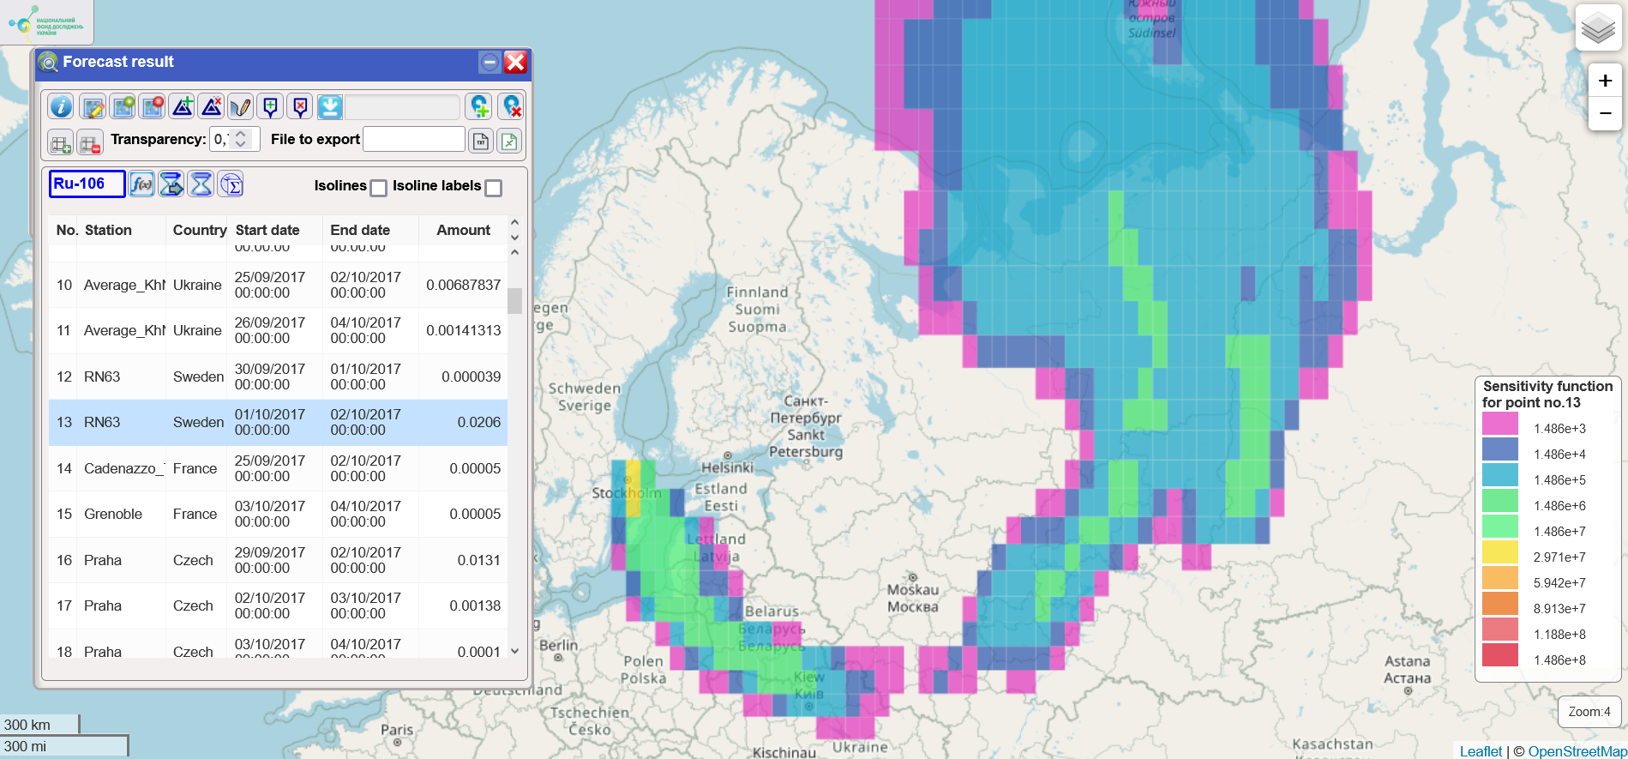
Sensitivity function, calculated by solving backward equations of atmospheric transport for Stockholm station
This indicator displays the area from which contamination could have originated for this specific measurement point
Notes:
The first is the sensitivity function. This function indicates the area from which contamination could have originated. Colors represent the expected level of contamination — red indicates a lower required emission volume at the time of detection, while blue indicates a higher emission volume. The red zone represents closer sources, needing smaller emissions to be detectable. The further the pollution travels, the more it disperses, and thus the larger the emission required.
On this slide we can see sensitivity function for Sweden station RN63.

Slide 109
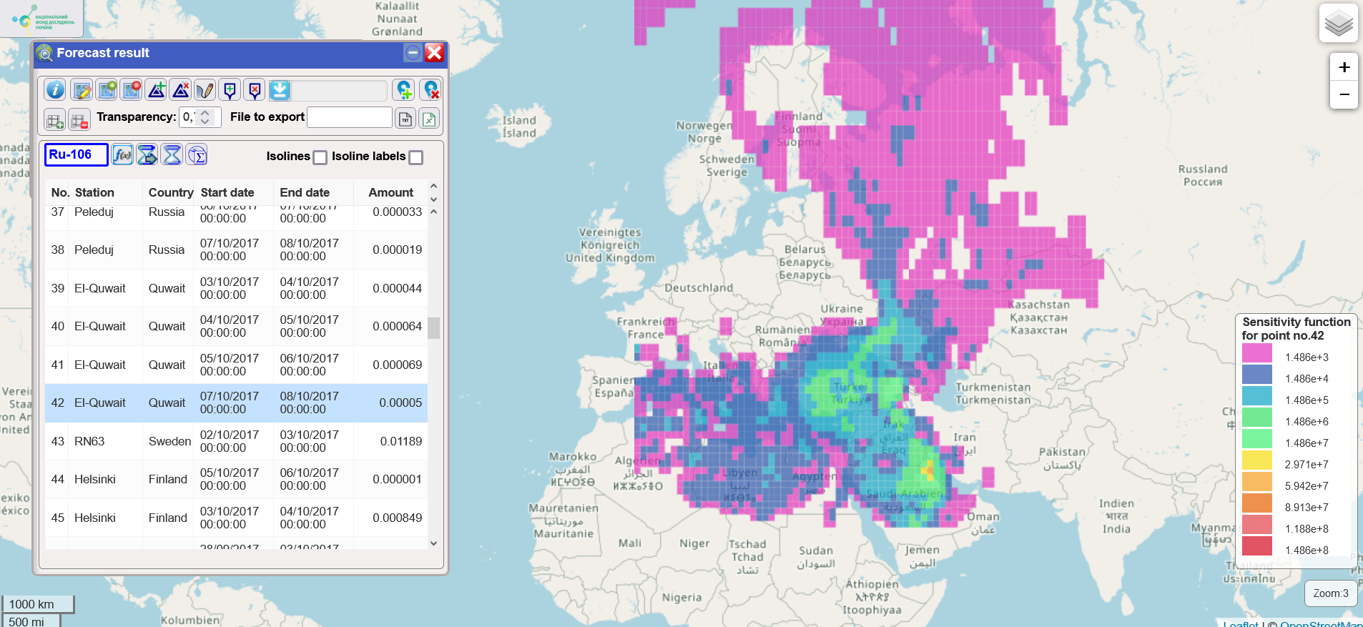
Same as previous slide, but for El-Kuwait station
Notes:
here, the same as previous, the sensitivity function is shown, but for another station, El-Kuwait in Kuwait country.

Slide 110
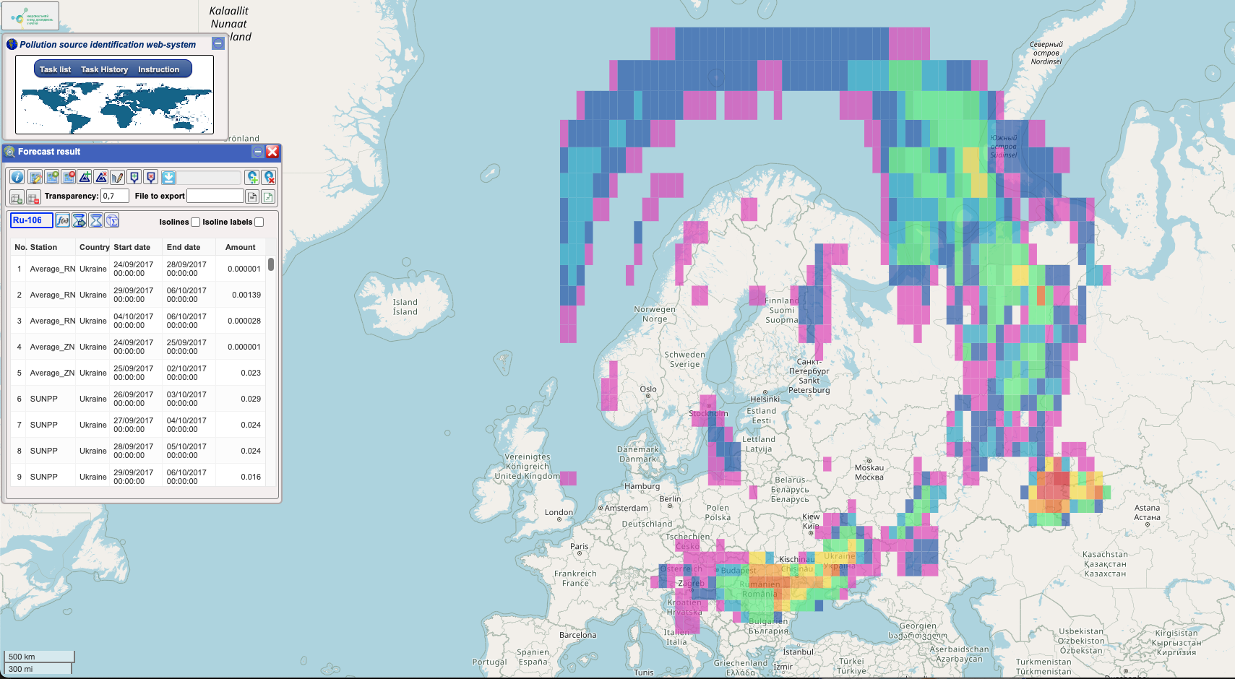

Normalized correlation function
Notes:
Spatial distribution of the normalized correlation coefficient of simulated vs. measured concentrations depending on the coordinates of the source, calculated by the system(whole computational domain).
The higher the value of the correlation function, the more likely it is that the source is located at that specific point. The density of the correlation function corresponds to the probability density of the source location. A high correlation between measurements and model output (max value of 1) is observed if the release occurred within the red zone.

Slide 111

Correlation function used as approximation of probability density distribution
With probability P=0.93 (93%) source is located in the domain, restricted by isoline of normalized correlation function r=0.1
111
111
Notes:
In this slide, as on the previous one, the correlation function, but at the same time the map is enlarged near the probable source of the emission(Mayak enterprise). As seen from the figure, according to the calculations by the System with probability P=0.93 (93%) source is located in the domain, restricted by isoline of normalized correlation function=0.1.
The figure shows that maximum of the cost function is located very close to the processing plant of radioactive waste Mayak enterprise, Rassian Federation. Most studies indicate this as also the most probable source.

Slide 112

Release Start Time (in Hours from the Beginning of Model Calculation)
Notes:
Release Start Time: The further a cell is from the station, the longer it takes for the emission to reach that station. This value indicates the estimated start time of the release relative to the model's start. The maximum value of the emission start time about 49 hours.
Чим далі від станіції знах комірка тим більше час потряпляння на цю станцію.
У моделі 0 це початок роботи моделі.

Slide 113


Calculated Release Duration in Hours
Notes:
Calculated release duration in hours, The maximum value of the estimated burst duration is about 236 hours.
Розрахована тривалість викиду.

Slide 114


Total released mass in Becquerel depending on assumed source location
Notes:
The last one is total release mass in Becquerel depending on assumed source location. As seen from the figure in the area around the most probable source location (Mayak entherprise) the emitted inventory is within the range from order of ~10 terabecquerel (TBq) to order ~100 terabecquerel (TBq), which agrees well with previous studies.
As seen from the figure in the area around the most probable source location (Mayak entherprise) the emitted inventory is within the range from ~10TBq to ~100 TBq, which agrees well with previous studies.

Slide 115
Final remarks
Future FLEXPART applications in joint work may include:
Finalizing forward dispersion modeling for Fukushima, producing global deposition fields for marine transport model
Performing a new STE study for Fukushima, taking into consideration possible variability in meteorological data and size distribution with the ensemble STE method
Evaluation of global atmospheric transport and fallout on Ocean of the radionuclides following Chernobyl accident for further use by marine transport model
Adaptation for use in operational mode in joint model chain with the POSEIDON marine transport and dose assessment code

Slide 116
Thank you for attention!
116
Notes:
Conclusions: We have developed a pilot system that enables the modeling and analysis of potential sources in cases of detection by monitoring networks. This system can analyze the probability of source location at specific points, the emission duration based on location, the release volume, and the emission start time. It is designed to be used when contamination of unknown origin is detected.
Йод, цезій стронцій найбільш довго живучі і їх простіше ідинтифікувати(6), але їх можна розширювати.

